Slide 1
“BSG TIPSS Guidelines”
Jo Leithead
Consultant Hepatologist
Forth Valley Royal Hospital

Slide 2
“TIPSS”
(in oesophageal variceal haemorrhage)
Dr Jo Leithead Consultant Transplant Hepatologist
Dr TC See
Consultant Internventional Radiologist
Innovation and excellence in health and care
Notes:
Covered last year but thought timely to rediscuss….

Slide 3
Notes:
Published online Feb 2020
Plus worth going over briefly variceal haemorrhage again because a few updates

Slide 4
Today…
Update on TIPSS for variceal haemorrhage
  Early TIPSS
  Determining futility
  During the COVID-19 pandemic
TIPSS for ascites
Notes:
Sneak previews

Slide 5
Patient X
47M, Primary biliary cholangitis diagnosed 2009 on serology and biopsy
January 2014 - presents via GP with malaena; “small oesophageal varices” and no intervention
August 2014 – represents with definite oesophageal variceal haemorrhage; band ligation x4 and commenced on Carvedilol 12.5mg od

Slide 6
Why worry?
UK Upper GI bleeding Audit May 1-June 30 2007
526/6750 patients admitted with acute upper GI bleeding and scoped during same admission had bleeding varices (10.5%).
Of these patients:
Rebleeding during the same admission in 26%
Inhospital mortality rate 15%
Patients who survive a first variceal haemorrhage are at high risk of rebleeding (over 60% at 1 year), and mortality from each rebleeding episode is about 20%.
Bosch J, Lancet 2003
Jaraith V, Dig Liver Dis 2014
Notes:
Why worry at this stage

Slide 7
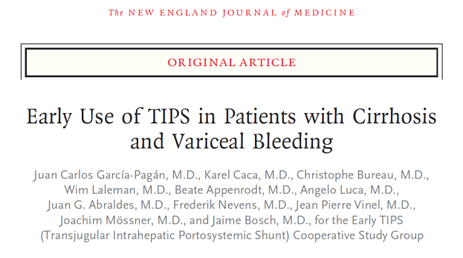
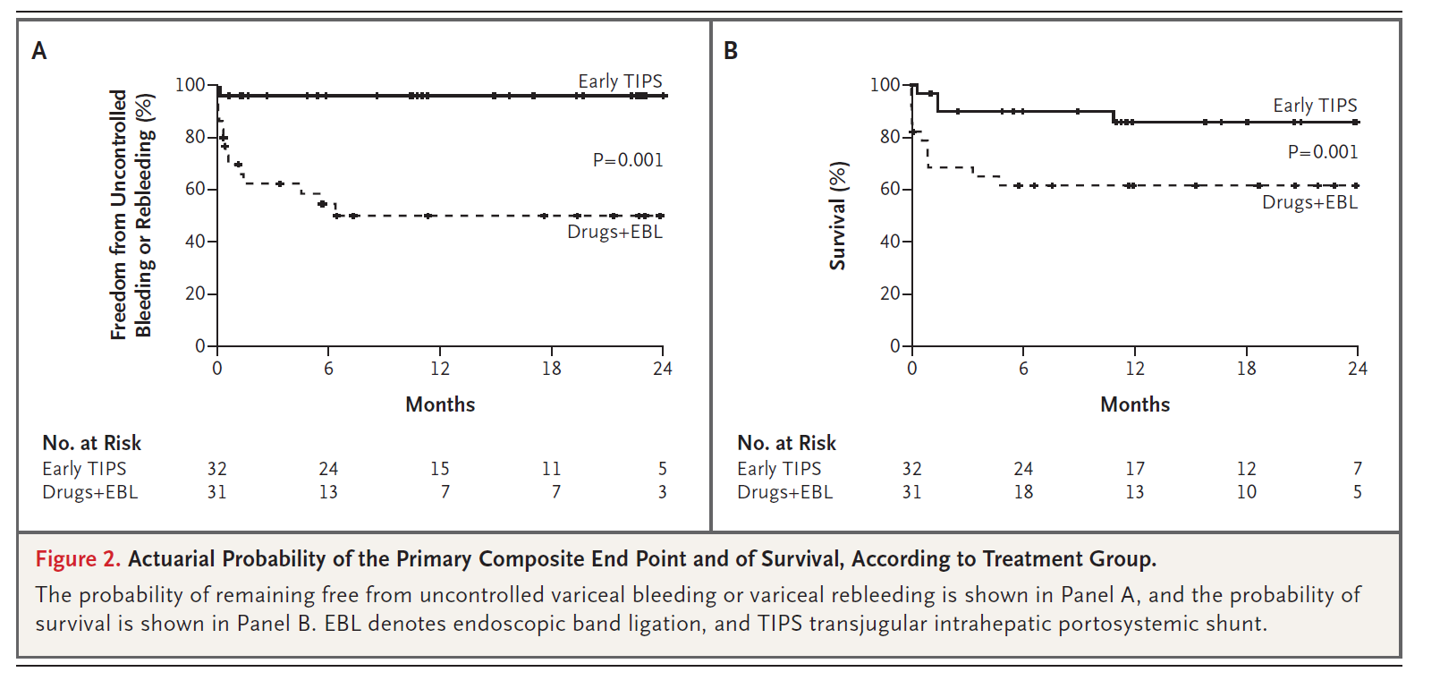
Early TIPSS
Garcia-Pagan JC, NEJM 2010
Notes:
Early ie within 72 hrs after 1st bleed.
We randomly assigned, within 24 hours after admission, a total of 63 patients with cirrhosis and acute variceal bleeding who had been treated with vasoactive drugs plus endoscopic therapy to treatment with a polytetrafluoroethylene-covered stent within 72 hours after randomization (early-TIPS group, 32 patients) or continuation of vasoactive-drug therapy, followed after 3 to 5 days by treatment with propranolol or nadolol and long-term endoscopic band ligation (EBL), with insertion of a TIPS if needed as rescue therapy (pharmacotherapy–EBL group, 31 patients).

Slide 8
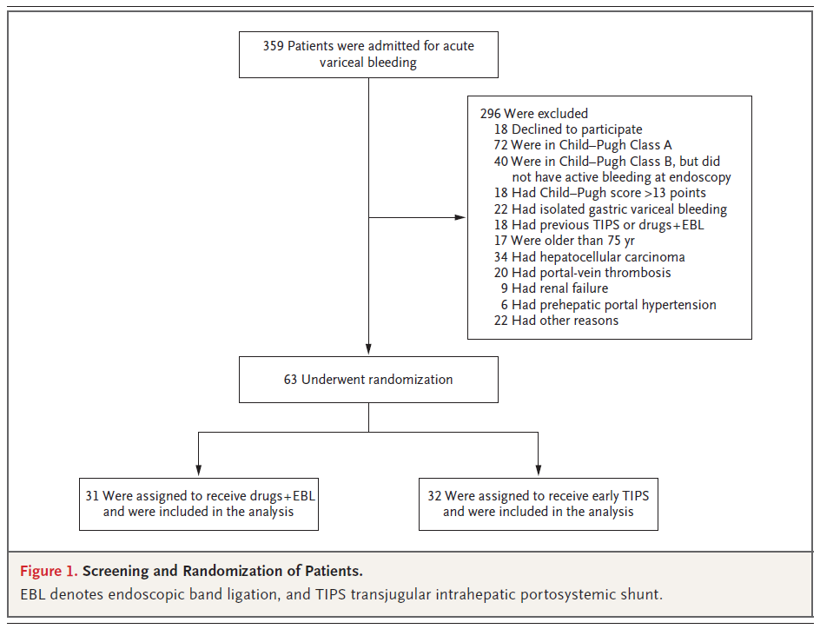
Early TIPSS – too good to be true??
Highly select group
Higher than expected rebleeding rate in the non TIPSS arm
  32% rebleeding rate with 50% mortality during mean FU time 10 months
  (Expected 39% rebleed rate with 20% mortality during 14-23 month FU)
Lower than expected rebleeding in the TIPSS arm
  0% rebleeding rate during mean FU time 14 months
  (Expected 7% rebleed rate by 2-years, but most ~6-12 months)
Garcia-Pagan JC, NEJM 2010
Sauerbruch T, Gastroenterology 2015
Albillos A, Hepatology 2017
Notes:
We randomly assigned, within 24 hours after admission, a total of 63 patients with cirrhosis and acute variceal bleeding who had been treated with vasoactive drugs plus endoscopic therapy to treatment with a polytetrafluoroethylene-covered stent within 72 hours after randomization (early-TIPS group, 32 patients) or continuation of vasoactive-drug therapy, followed after 3 to 5 days by treatment with propranolol or nadolol and long-term endoscopic band ligation (EBL), with insertion of a TIPS if needed as rescue therapy (pharmacotherapy–EBL group, 31 patients).
Expected rate for rebleeding in VBL + NSBB arm of the Albillos metaanalysis.

Slide 9
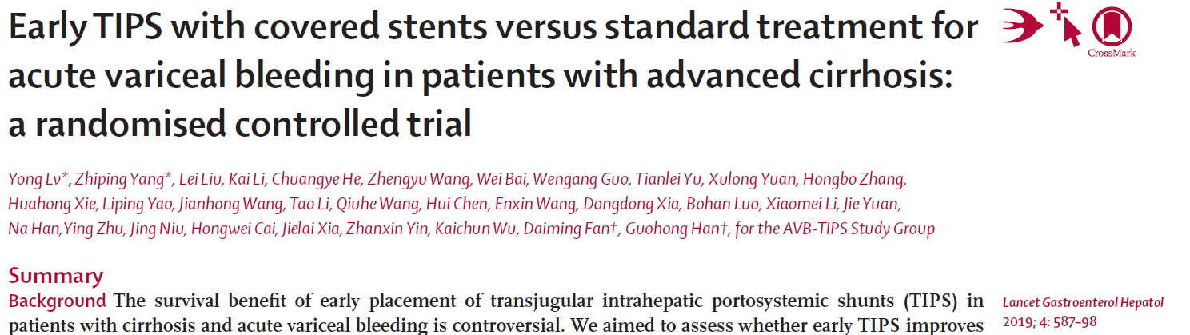
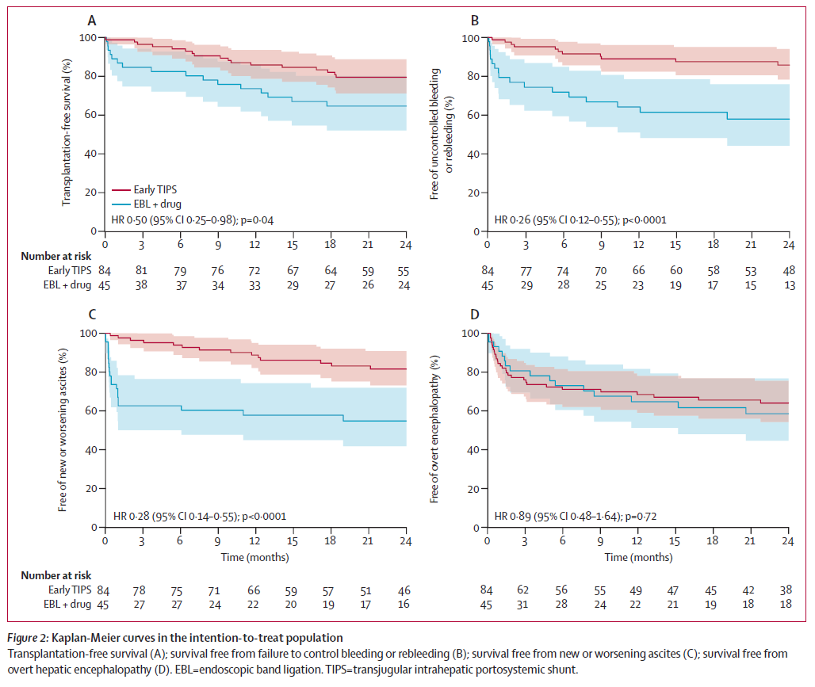
Early TIPSS – too good to be true??
1/3 screened randomised
More realistic outcomes
But may not be applicable to our cohort
  75% had HBV cirrhosis
  Less sick than the Garcia-Pagan cohort (25% CPC vs 50%)
  Lesser proportion of encephalopathy at baseline
Notes:
China – Lancet Gastroenterol Hepatology
In conclusion, among patients with advanced cirrhosis and acute variceal bleeding, early TIPS is superior to drugs plus endoscopic treatment in improving transplantation-free survival, reducing further bleeding and new or worsening ascites without increasing the risk of overt hepatic encephalopathy. Our results favour the early use of TIPS in patients with advanced cirrhosis and acute variceal bleeding. Future studies addressing whether early TIPS can be equally recommended in Child-Pugh B and C patients are warranted.

Slide 10
Early TIPSS – too good to be true??
206 screened, 58 randomised
Comparative cohort to NEJM trial
4 patients randomised to early-TIPSS did not have the procedure because of logistical/practical issues; 10 patients had their TIPSS outside the 72-hr window
Early TIPSS reduced variceal rebleeding (1/23 vs 8/29) but had no impact on survival, and was associated with increased encephalopathy (46% vs 21%)
Notes:
UK more real world study, presented at BSG 2019.
Cirrhotic patients with a Childs Pugh (CP) score ≥8 presenting to either centre with VB were considered for inclusion in the study. Following haemostasis with endoscopic band ligation (EBL) and vasoactive drugs, consenting participants were randomised to either continued EBL ± non-selective beta-blockers (standard care) or early-TIPSS (ie within 72hrs). All patients were followed up for 1 year, or until death. The primary endpoint was survival at 1 year. Secondary endpoints included early and late re-bleeding (<6 weeks and 6 weeks - 1 year). The study was completed between April 2012 – January 2018.
The 1-year transplant-free survival in the control arm was significantly better than in the 2010 study (76% vs 61%),28 suggesting improvements in overall care of patients with acute variceal bleeding in the past decade, and extrapolation of results from the 2010 study to the present time needs careful consideration.
Reduced rebleed rate but comparative survival. Not all patients randomised to TIPSS received the intervention in time.
Early-TIPSS reduced variceal rebleeding, increased encephalopathy but had no effect on survival in high-risk patients with oesophageal variceal bleeding. Early-TIPSS may not be feasible in many centres however, larger studies are needed.

Slide 11
Notes:
1425 consecutive patients admitted to 12 hospitals in China over 6 years with cirrhosis and variceal bleeding – 206 underwent early TIPSS. Competing risk analysis.
Objectives: Early placement of transjugular intrahepatic portosystemic shunt (TIPS) has been shown to improve survival in high-risk patients (Child-Pugh B plus active bleeding at endoscopy or Child-Pugh C 10-13) with cirrhosis and acute variceal bleeding (AVB). However, early TIPS criteria may overestimate the mortality risk in a significant proportion of patients, and the survival benefit conferred by early TIPS in such patients has been questioned. Alternative criteria have been proposed to refine the criteria used to identify candidates for early TIPS. Nevertheless, the true survival benefit provided (or not) by early TIPS compared with standard treatment in the different risk categories has not been investigated in specifically designed comparative studies.
After adjusting for liver disease severity and other potential confounders, a survival benefit was observed in MELD ≥19 or Child-Pugh C patients but not in MELD ≤11 or Child-Pugh A patients. In MELD 12-18 patients, a survival benefit was observed within 6 weeks but not at 1 year. In Child-Pugh B patients, a survival benefit was observed in those with active bleeding but not those without active bleeding. However, the evaluation of active bleeding was associated with a high interobserver variability. Furthermore, early TIPS was associated with a significantly reduced incidence of failure to control bleeding or rebleeding and new or worsening ascites, without increasing the risk of overt hepatic encephalopathy.
Conclusions: Early TIPS was associated with improved survival in patients with MELD ≥19 or Child-Pugh C cirrhosis but not in patients with MELD ≤11 or Child-Pugh A cirrhosis. For MELD 12-18 or Child-Pugh B patients, future studies addressing optimal selection criteria for early TIPS remain highly warranted.

Slide 12
BSG TIPSS guidelines
Notes:
Original recommendation: There is conflicting evidence on the efficacy of early TIPSS with 72 hours of a variceal bleed in haemodynamically stable patients, and as such early or pre-emptive TIPSS is not recommended (strong recommendation, high quality evidence). Large multi-centre trials are necessary to determine the role of pre-emptive TIPSS in acute variceal bleeding, and whether all patient sub-groups benefit
Recommendation in published guideline after peer review: In patients who have Child’s C disease (C10-13) or MELD ≥19, and bleeding from oesophageal varices or GOV1 and GOV2 gastric varices and are haemodynamically stable, early or pre-emptive TIPSS should be considered within 72hours of a variceal bleed where local resources allow (weak recommendation, moderate quality of evidence). However, large multi-centre RCTs are necessary to determine whether patients with Child’s B disease and active bleeding or with MELD 12–18 benefit from early pre-emptive TIPSS.

Slide 13
BSG TIPSS guidelines
In patients who have Child’s C disease (C10-13) or MELD ≥19, and bleeding from oesophageal varices or GOV1 and GOV2 gastric varices and are haemodynamically stable, early or pre-emptive TIPSS should be considered within 72hours of a variceal bleed where local resources allow (weak recommendation, moderate quality of evidence). However, large multi-centre RCTs are necessary to determine whether patients with Child’s B disease and active bleeding or with MELD 12–18 benefit from early pre-emptive TIPSS.
Notes:
Original recommendation: There is conflicting evidence on the efficacy of early TIPSS with 72 hours of a variceal bleed in haemodynamically stable patients, and as such early or pre-emptive TIPSS is not recommended (strong recommendation, high quality evidence). Large multi-centre trials are necessary to determine the role of pre-emptive TIPSS in acute variceal bleeding, and whether all patient sub-groups benefit
Recommendation in published guideline after peer review: In patients who have Child’s C disease (C10-13) or MELD ≥19, and bleeding from oesophageal varices or GOV1 and GOV2 gastric varices and are haemodynamically stable, early or pre-emptive TIPSS should be considered within 72hours of a variceal bleed where local resources allow (weak recommendation, moderate quality of evidence). However, large multi-centre RCTs are necessary to determine whether patients with Child’s B disease and active bleeding or with MELD 12–18 benefit from early pre-emptive TIPSS.

Slide 14
Patient X
47M, Primary biliary cholangitis diagnosed 2009 on serology and biopsy
January 2014 - presents via GP with malaena; “small oesophageal varices” and no intervention
August 2014 – represents with definite oesophageal variceal haemorrhage; band ligation x4 and commenced on Carvedilol 12.5mg od
No follow up gastroscopy
October 2014 – further confirmed oesophageal variceal haemorrhage; band ligation x 2; noted to have progressive liver synthetic dysfunction and referred for liver transplant assessment

Slide 15
Secondary prophylaxis of Rebleeding
No trials looking specifically at preventing rebleeding after 2nd variceal haemorrhage.
None of the trials looking at secondary prophylaxis perfect.
Total 306 patients included in trials of covered stents.
But ….
  3 trials of covered TIPSS vs VBL+NSBB have shown reduced variceal rebleeding rate (0-7% vs 26% by 2-years; 25% vs 50% if PVT)
  Only 1 of the trials showed a trend towards increased encephalopathy (previous non serious/refractory encephalopathy included in 2), with no difference in quality of life in the same trial
  No difference in survival
  But TIPSS more cost effective
Jalan R, Hepatology 1997
Harman DJ, Eur J Gastroenterol Hepatol 2013
Sauerbruch T, Gastroenterology 2015
Tripathi D, Gut 2015
Holster IL, Hepatology 2016
Lv Y, Gut 2018
Notes:
The role for TIPSS in secondary prophylaxis not clear cut.
1 trial included gastric varices, 1 portal vein thrombosis
Previous non covered stent trials showed reduced rebleeding and no difference in survival but increased encephalopathy

Slide 16
BSG TIPSS guidelines
Notes:
In secondary prevention of oesophageal variceal bleeding, TIPSS can be considered where patients rebleed despite combination of VBL +NSBB taking into account the severity of rebleeding and other complications of portal hypertension, with careful patient selection to minimise hepatic encephalopathy (weak recommendation, moderate-quality evidence). Further large controlled trials are required to investigate the role of TIPSS as first-line therapy in secondary prevention (strong recommendation, low quality of evidence).

Slide 17
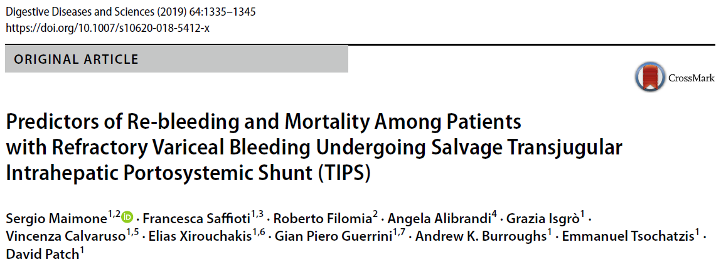
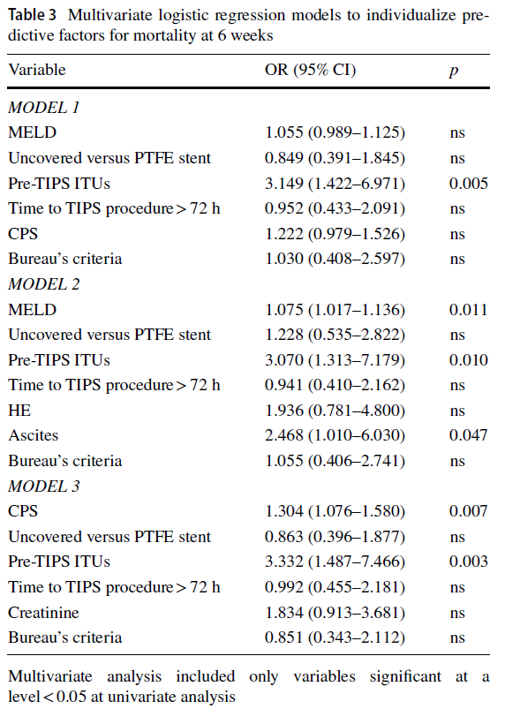
Leaving it to salvage means worse outcome
144 patients undergoing salvage TIPSS 1992 to May 2008
53% in ITU pre TIPSS; 46% ventilated
Overall 6-week and 12-month mortality was 36% and 42%, respectively
For the 63 CPS 10-13 patients the 6 week survival was 29.4%
All 10 patients in CPS 14–15 died within 6 weeks
Notes:
Salvage = acute portal hypertensive bleeding (PHB) that fail endoscopic and/or pharmacological therapy
Non contemporary data – mixture of covered and non covered
Nevertheless largest series to date.
Limited data otherwise – only Azoulay D¹, Castaing D, Majno P, Saliba F, Ichaï P, Smail A, Delvart V, Danaoui M, Samuel D, Bismuth H. (58 patients) and published in 2001 (jHep)

Slide 18
BSG TIPSS guidelines
Notes:
In secondary prevention of oesophageal variceal bleeding, TIPSS can be considered where patients rebleed despite combination of VBL +NSBB taking into account the severity of rebleeding and other complications of portal hypertension, with careful patient selection to minimise hepatic encephalopathy (weak recommendation, moderate-quality evidence). Further large controlled trials are required to investigate the role of TIPSS as first-line therapy in secondary prevention (strong recommendation, low quality of evidence).

Slide 19
Cambridge experience
Naik K, Cacciottolo T, See T, Leithead JA, BASL 2020
Notes:
37 consecutive salvage TIPSS.
Six patients had a pre TIPSS Child-Pugh score of >13: 3 died within 6-weeks; one was considered for transplantation but declined because of recidivism risk, dying at 251 days; one recovered and died unexpectedly at 131 days; and one is still alive at 684 days of followup (Figure 1C).
Blood lactate immediately pre TIPSS was higher in patients who died by 6-weeks (p=0.008, Figure 1B). The 6-week mortality rate was 12%, 40% and 75% for patients with a lactate of <1.8, 1.8-2.5, and ≥2.6 mmol/l, respectively (p=0.002, Figure 1D). Seven of 8 patients with a lactate ≥2.6 mmol/l had died by 1-year with a median time to death of 15 (range 1-52) days.
Conclusions:
Child-Pugh score >13 is not a definitive indicator of short term mortality in patients undergoing salvage TIPSS – however in this group long term mortality is high and TIPSS should be viewed as a bridge to liver transplantation.
Blood lactate instead may be a superior predictor of futility.

Slide 20
Learning points
Primary prophylaxis of small (grade 1 without red spots) oesophageal varices not currently recommended.
Early TIPSS (<72 hours post bleed; haemostasis achieved) is not currently recommended.
In patients who have a second variceal haemorrhage despite combination therapy (or if intolerant or non compliant), consider the risk benefit ratio of TIPSS.
In bleeding refractory to endoscopic and drug therapy, salvage TIPSS is recommended (although a Child-Pugh score of >13 may be an indicator of futility).

Slide 21
Learning points
Primary prophylaxis of small (grade 1 without red spots) oesophageal varices not currently recommended.
Early TIPSS (<72 hours post bleed; haemostasis achieved) should be considered where local resources allow in CPC (10-13) or MELD ≥19.
In patients who have a second variceal haemorrhage despite combination therapy (or if intolerant or non compliant), consider the risk benefit ratio of TIPSS.
In bleeding refractory to endoscopic and drug therapy, salvage TIPSS is recommended (although a Child-Pugh score of >13 may be an indicator of futility).

Slide 22
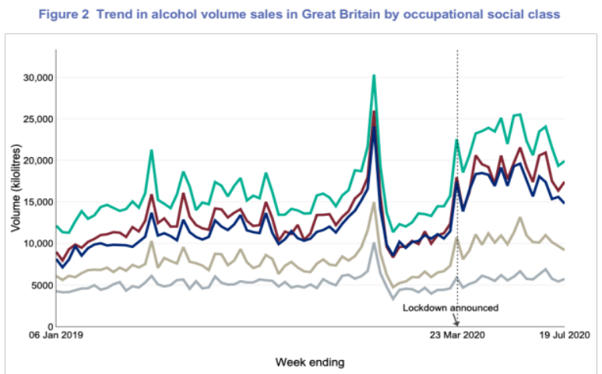
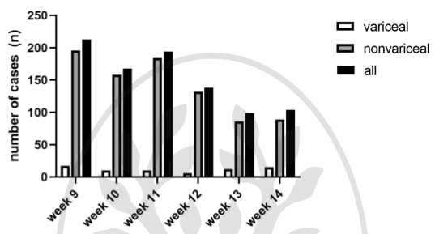
But what about COVID-19?
St Mary’s Hospital London survey of patients with known alcohol use disorder:
17% admitted to relapse during lockdown (mean consumption 49u/week)
24% reported increased alcohol consumption (mean 83u/week)
Figure 1: Decline in acute upper gastrointestinal bleeding episodes in Austria in the 3 weeks prior to and after lockdown during Covid-19 pandemic.
Schmiderer A, Endoscopy 2020
Kim JU, Lancet Gastroenterol Hepatol 2020
Second Institute of Alcohol Studies Briefing Oct 2020
Notes:
Left Austria – no change in variceal bleeding rates in 3 weeks pre and post lockdown i.e. presumed peak of pandemic.
IAS figure – home alcohol consumption during the pandemic in relation to announcement of lockdown - ? What caused peak in early March. A breakdown by occupational social grade (figure 2) shows an increase alcohol purchasing in all groups except for those belonging to the lowest occupational social grade (people on long term state benefits, casual and lowest grade workers, unemployed with state benefits (including pension)), but that the increase in alcohol purchasing was largest among the more advantaged occupational groups.

Slide 23
Preventing bleeding whilst minimizing contact
Already on 1° prophylaxis
Treatment naive
Already on 2° prophylaxis
OGD in last 1-yr
Last OGD >1-yr
Ensure on carvedilol
Priority for VBL
Recent bleed
Bled despite NSBB/good VBL
Multiple previous bleeds
Alcohol excess ++
Bleed >6 months ago – defer FU VBL
Carvedilol – ensure optimal dose
VBL – VBL in last 6-12 months start carvedilol
Gd 1 OV with
Red signs OR
Childs Pugh C OR
Alcohol excess ++
Gd 2/3 OV
Large GV
Severe AAH
Childs Pugh C
Consider in CP A/B +
Portal HPT on imaging OR
Alcohol excess ++
Start carvedilol
If NSBB CI or intolerance – OGD +/- VBL
CUH COVID guideline 2020

Slide 24
The worst case scenario
Loss of out of hours endoscopy service
Increased demand for TIPSS
Increase in variceal bleeding
GRIDLOCK IN ITU

Slide 26
Today…
Update on TIPSS for variceal haemorrhage
  Determining futility
  During the COVID-19 pandemic
TIPSS for ascites

Slide 27
Patient Y
67F NASH cirrhosis diagnosed 2016 after an incidental finding of thrombocytopenia
Comorbidity – obesity, BMI 31; type 2 diabetes mellitus, tablet controlled 6 years; dyslipidaemia
End July 2020 – presents with oesophageal variceal haemorrhage; haemostasis with band ligation; carvedilol 12.5mg od and banding programme as secondary prophylaxis
Early August 2020 – represents with large volume ascites; paracentesis 10L
Since – 4 paracenteses, approx 2-4 week intervals
Referred for TIPSS

Slide 28
TIPSS for refractory ascites
Conclusion – “These findings support TIPSS as the first-line intervention in such patients.”
However:
  Small numbers (29 vs 33)
  Not matched at baseline (LVP+A had trend towards lower Na, higher rate of SBP and enceph at baseline)
  90% ALD
  15/33 LVP+A patients underwent TIPSS within 6 months (censored)
Figure 1. Probability of survival without liver transplant in TIPSS and LVP+A group.
Notes:
Took 4 centres 7 years to recruit patients, highly select.

Slide 29
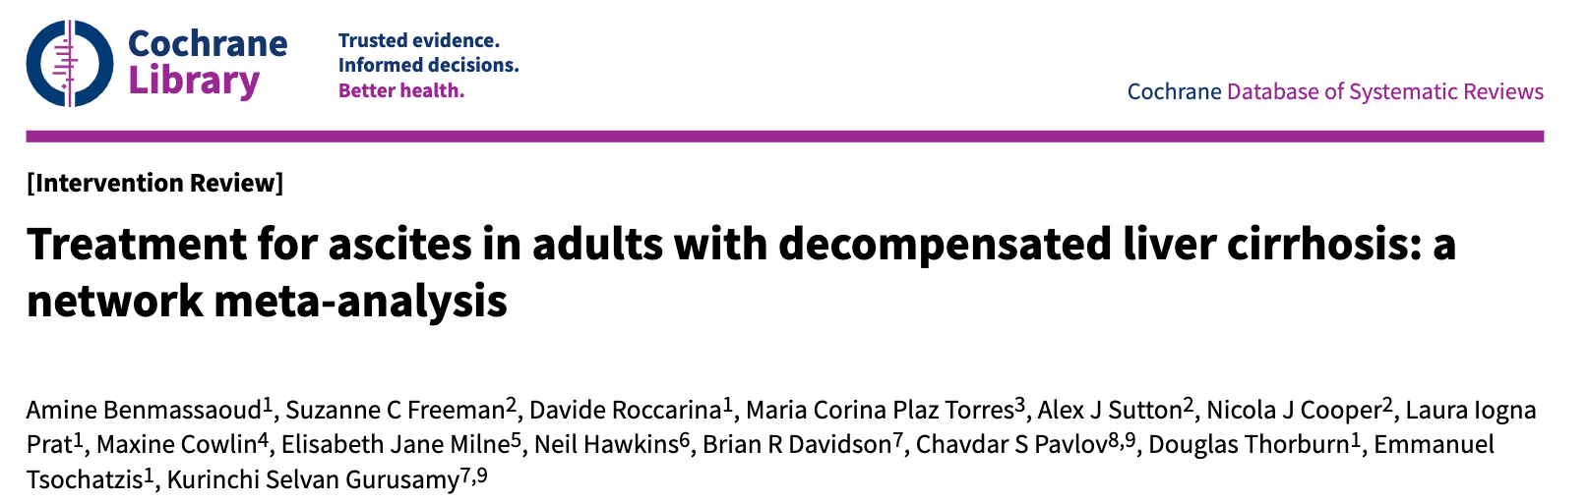
TIPSS for refractory ascites
Authors' conclusions:
  Based on very low‐certainty evidence, TIPSS may increase the resolution of ascites compared to paracentesis plus fluid replacement.
  Based on very low‐certainty evidence, there is considerable uncertainty about whether TIPSS for ascites decreases mortality.
Notes:
Small nos, heterogeneity of cases, bare stents/evolving practice.
There was no evidence of differences in mortality, adverse events, or liver transplantation in people receiving different interventions compared to paracentesis plus fluid replacement (very low‐certainty evidence).
None of the trials reported quality of life.

Slide 30
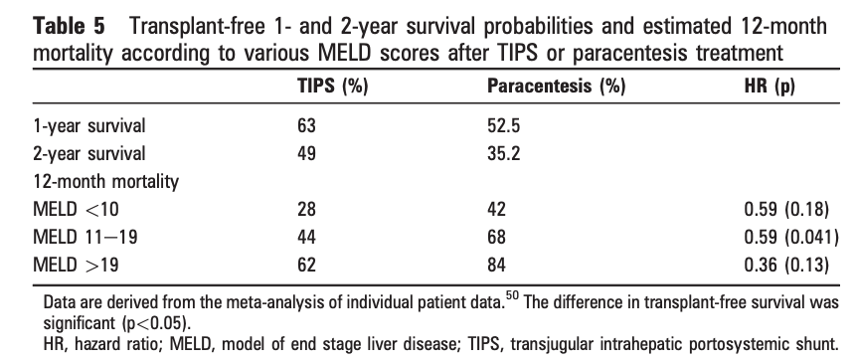
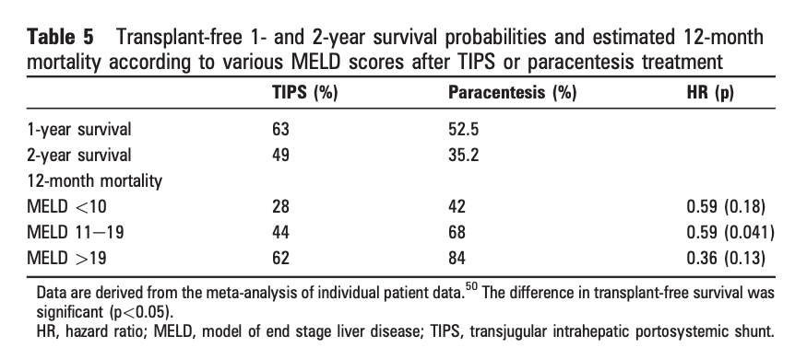
TIPSS for refractory ascites
Rossle M, Gut 2010

Slide 31
BSG TIPSS Guidelines
In patients who are eligible for liver transplantation, TIPSS for ascites should only be undertaken after discussion with the regional transplant centre (strong recommendation, very low-quality evidence).
In selected patients with refractory or recurrent ascites, we recommend insertion of TIPSS provided there are no contraindications to the procedure (strong recommendation, high-quality evidence).
Contraindications being - bilirubin >50 and platelets <75, pre-existing encephalopathy, active infection, severe cardiac failure/pulmonary hypertension (strong recommendation, moderate- quality evidence).
Bureau C, J Hepatol 2011
Notes:
Potential survival benefit of transplant in the low risk Bureau group

Slide 32
Patient Y
67F NASH cirrhosis diagnosed 2016 after an incidental finding of thrombocytopenia
Comorbidity – obesity, BMI 31; type 2 diabetes mellitus, tablet controlled 6 years; dyslipidaemia
End July 2020 – presents with oesophageal variceal haemorrhage; haemostasis with band ligation; carvedilol 12.5mg od and banding programme as secondary prophylaxis
Early August 2020 – represents with large volume ascites; paracentesis 10L
Since – 4 paracenteses, aprox 2-4 week intervals
Referred for TIPSS

Slide 33
Patient Y
67F NASH cirrhosis diagnosed 2016 after an incidental finding of thrombocytopenia
Comorbidity – obesity, BMI 31; type 2 diabetes mellitus, tablet controlled 6 years; dyslipidaemia
End July 2020 – presents with oesophageal variceal haemorrhage; haemostasis with band ligation; carvedilol 12.5mg od and banding programme as secondary prophylaxis
Early August 2020 – represents with large volume ascites; paracentesis 10L
Since – 4 paracenteses, aprox 2-4 week intervals
Referred for TIPSS
Irreversible disease process
Notes:
I view it as a palliative process – in the absence of survival benefit must improve quality of life and none of the trials have looked at that.

Slide 34
Patient Y
67F ALD cirrhosis diagnosed 2016 after an incidental finding of thrombocytopenia
Comorbidity – obesity, BMI 31; type 2 diabetes mellitus, tablet controlled 6 years; dyslipidaemia
End July 2020 – presents with oesophageal variceal haemorrhage; haemostasis with band ligation; carvedilol 12.5mg od and banding programme as secondary prophylaxis
Early August 2020 – represents with large volume ascites; paracentesis 10L
Since – 4 paracenteses, aprox 2-4 week intervals
Referred for TIPSS

Slide 35
Longest and best
possible life
TIPSS
Medical
Transplant
Notes:
Medical – palliation or watch and wait to see if improves

Slide 36
Patient Y
67F ALD cirrhosis diagnosed 2016 after an incidental finding of thrombocytopenia
Comorbidity – obesity, BMI 31; type 2 diabetes mellitus, tablet controlled 6 years; dyslipidaemia
End July 2020 – presents with oesophageal variceal haemorrhage; haemostasis with band ligation; carvedilol 12.5mg od and banding programme as secondary prophylaxis
Early August 2020 – represents with large volume ascites; paracentesis 10L
Since – 4 paracenteses, aprox 2-4 week intervals
Bilirubin 40, albumin 29, INR 1.4, creatinine 161, platelet count 105
Notes:
eGFR 29

Slide 37
TIPSS in patients with renal dysfunction
Hepatorenal syndrome
Although, renal function has been observed to improve following TIPSS, TIPSS for HRS (type 1 and type 2) remains experimental (weak recommendation, very low level of evidence).
Intrinsic renal disease
In patients with significant intrinsic renal disease (stage 4/5), elective TIPSS is not recommended (strong recommendation, low-quality evidence).
TIPSS can be considered in patients presenting acutely with variceal bleeding and renal dysfunction (weak recommendation, very low-level evidence).
Notes:
The severity of liver disease usually precludes TIPSS in patients with severe portal hypertension-related renal dysfunction (type 1 and type 2HRS). The poor residual liver function does not cope with the reduced portal inflow, with an increased risk of hepatic encephalopathy, and a potential unmasking of cirrhotic cardiomyopathy. Although, renal function has been observed to improve following TIPSS, TIPSS for HRS remains experimental.56 89 90 A recent systematic review demonstrates the paucity of good-quality data, and heterogeneity with regards to patient selection and outcomes.91 Furthermore, in type 2HRS patients with more severe renal dysfunction were excluded. The rate of hepatic encephalopathy approached 50% which is significantly higher than for other indications. Finally, most studies
Renal function Differentiating portal hypertension-related renal dysfunction from intrinsic kidney disease, and acute kidney injury from stable chronic renal disease, is probably important. However, there is limited supporting evidence at present: the RCTs of TIPSS largely excluded patients with intrinsic kidney disease or significant renal dysfunction, with a mean baseline creatinine of 70–124 µmol/l.27 28 39 54–60 165–169 In portal hypertension-related renal dysfunction, reflecting more advanced disease, a higher serum creatinine is predictive of post-TIPSS mortality.77 170 In portal hypertension-related renal dysfunction and intrinsic kidney disease, a higher baseline serum creatinine may be associated with a lesser natriuretic effect of TIPSS171 172 and an increased frequency of the development of hepatic encephalopathy.173 The presence of severe intrinsic kidney disease (stage 4/5) may lead to an unacceptably high rate of severe encephalopathy.174 The indication for TIPSS may also be relevant. In rescue TIPSS, renal dysfunction is often acute and the key determinant of the risk benefit ratio is multiorgan dysfunction. However, in elective TIPSS for refractory ascites, suitability for a life-prolonging liver transplant and quality of life should be the focus.

Slide 38
Patient Y
67F ALD cirrhosis diagnosed 2016 after an incidental finding of thrombocytopenia
Comorbidity – obesity, BMI 31; type 2 diabetes mellitus, tablet controlled 6 years; dyslipidaemia
End July 2020 – presents with oesophageal variceal haemorrhage; haemostasis with band ligation; carvedilol 12.5mg od and banding programme as secondary prophylaxis
Early August 2020 – represents with large volume ascites; paracentesis 10L
Since – 4 paracenteses, aprox 2-4 week intervals
Bilirubin 40, albumin 29, INR 1.4, creatinine 60, platelet count 105
Notes:
eGFR 29

Slide 39
Patient Y
67F ALD cirrhosis diagnosed 2016 after an incidental finding of thrombocytopenia
Comorbidity – obesity, BMI 31; type 2 diabetes mellitus, tablet controlled 6 years; dyslipidaemia
End July 2020 – presents with oesophageal variceal haemorrhage; haemostasis with band ligation; carvedilol 12.5mg od and banding programme as secondary prophylaxis
Early August 2020 – represents with large volume ascites; paracentesis 10L
Since – 4 paracenteses, aprox 2-4 week intervals
Bilirubin 40, albumin 29, INR 1.4, creatinine 60, platelet count 105
Notes:
eGFR 29

Slide 40
BSG TIPSS Guidelines

Slide 41
BSG TIPSS Guidelines

Slide 42
BSG TIPSS Guidelines

Slide 43
BSG TIPSS Guidelines
Notes:
Recommendations: cardiac assessments ► A cardiac history, examination, 12-lead ECG and N-Terminal pro-B-type natriuretic peptide (NT-proBNP) should be undertaken in all patients undergoing elective TIPSS insertion (strong recommendation, moderate-quality evidence). Further cardiac evaluation (echocardiogram +/-cardiology consultation) should be undertaken before elective TIPSS if any of these are abnormal (strong recommendation, moderate-quality evidence). ► Elective TIPSS is not recommended in patients with severe left ventricular dysfunction or severe pulmonary hypertension (strong recommendation, moderate- quality evidence). ► Echocardiogram in acute variceal haemorrhage may be inaccurate and should not delay an emergency, potential lifesaving TIPSS insertion (strong recommendation, low-quality evidence).
But studies in this context show selection bias with low rate of cardiac events post TIPSS – potentially selected out. LVEF/valvular disease may be relevant. Billey Hepatol 2019. A level of BNP <40 pg/mL and NT-proBNP < 125 pg/mL allowed identifying patients without risk of cardiac decompensation.
DD controversial.

Slide 44
Learning points
TIPSS in patients with refractory ascites increases the likelihood of ascites resolution, but has not been definitively shown to improve survival benefit.
The onset of refractory ascites in the absence of reversible liver disease signifies poor prognosis and liver transplantation should be considered.
TIPSS is best pursued in tandem with transplant assessment. In the absence of reversible liver disease, TIPSS is a palliative procedure.

Slide 45
BSG TIPSS Guidelines
Hepatic hydrothorax
Budd Chiari syndrome
Prophylaxis prior to surgery
Non cirrhotic portal hypertension
Portal vein thrombosis
Logistics

