Slide 1

Hepatitis C Operational Delivery Network

Slide 2

Background to the ODN
The Eastern Region Hepatitis C Operational Delivery Network (HCV ODN) was established in August 2015. It forms one of 22 HCV ODN nationally.
Our aim is to care for and treat all patients with HCV in the Eastern region. A team of highly dedicated and trained health care professionals deliver HCV care and treatment in settings that encourages patient engagement. We offer care and treatment in hospital clinics; out reach GP surgeries, drug and alcohol services, and prisons within the Eastern region. Allowing equitable and fair access to HCV care and treatment is the fundamental commitment of the Eastern region HCV ODN. Raising awareness of HCV through education and case finding is a priority in achieving the NHSE HCV elimination goal of 2025.
A CQUIN is attached to HCV which is heavily based on treatment numbers or “run rate”
The Eastern HCV ODN comprises the following centres
Notes:
The Eastern Region Hepatitis C Operational Delivery Network (HCV ODN) was established in August 2015. It forms one of 22 HCV ODN nationally.
A CQUIN is attached to HCV which is heavily based on treatment numbers or “run rate”

Slide 3
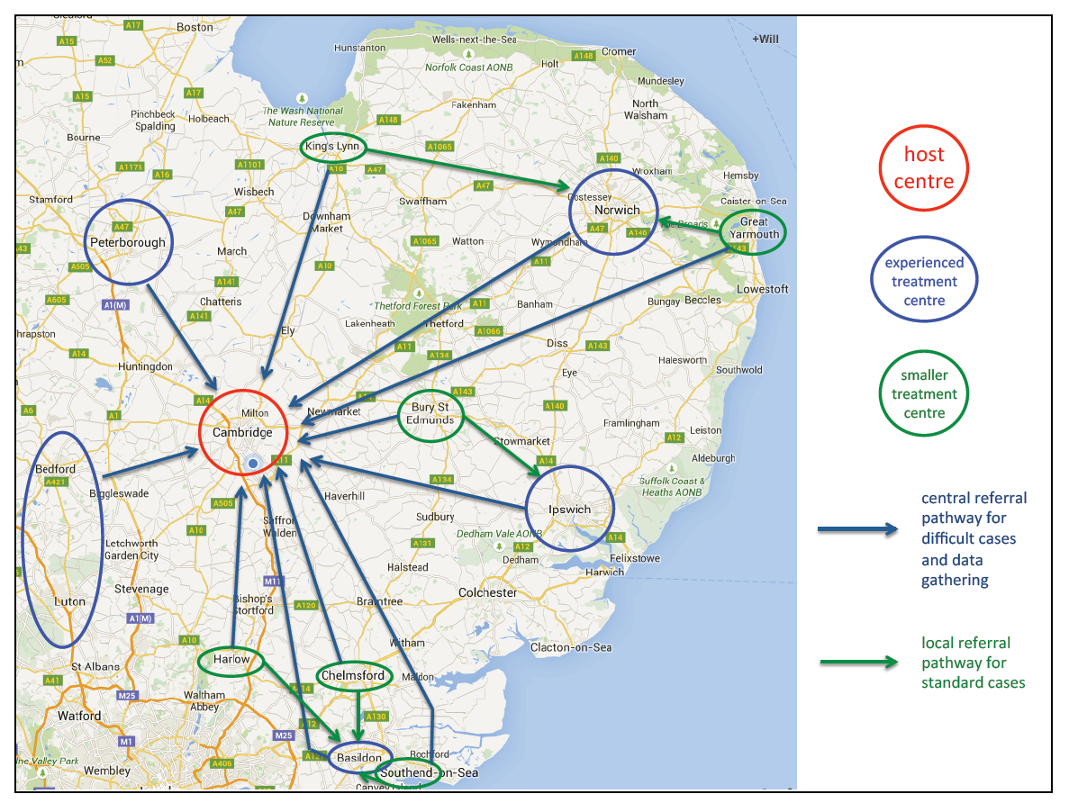
Notes:
CUH – HUB
Spokes – Peterborough, Norwich, Ipswich, Basildon, Luton, Bedford

Slide 4


Slide 5

Where we finished 2019/2020
Run rate for 2019/2020:
889 – 98% of target (target 907)
Outreach
Hep C Trust Peer
Prisons
Notes:
Well established Outreach service –
Novel approach – Colchester Stars: replicating similar prison approaches to treating in prison, in DAS on 6/3 and 13/3/20. 18 patients started on treatment.
Charlotte Brown HepC Trust Peer Support Lead now in place.
Warren Hill first prison HITT, tested 214 6 AB pos, 3 PCR pos - Norwich HMP took place at start of February – tested 601 prisoners and 6 officers – 64 positive/indeterminate results – 27 required treatment to date - 22 treatments ordered (11 new diagnosis). HITT – take a team of nurses, pharmacists, hep c trust, ODN staff with the aim to test every available prisoner. These HITTs involved regular planning meetings and collaborative working over the course of a number of months. The HITT takes place over a short period of time.
HCV nurses regularly hold clinics within the prisons

Slide 6
2020 - 2021
Run rate allocated for 2020/2021 – 556
Highest achieving ODN for treatments April 2020-October 2020
COVID19 response (Reengagement)
Outreach – CUH outreach clinics to resume from September 2020
Regionally we are waiting for DAS to re open and allow HCV CNS back into service.
Notes:
– Achieving 164% against running monthly target (418 treatments)
Covid Response
opportunity taken to establish reengagement with disengaged patients. Letters sent, phone calls to patients, text messages to patients, letters to GP.
Peer Support Lead – Charlotte has been calling known to services to try to reengage into treatment.
Patients are being offered telephone clinic appointments for HCV Clinics.
Has been extremely successful due to patients not having to leave their houses – medication is posted directly to them.

Slide 7
Notes:
Slide on activity during q2.
Covid has impacted on our source of referrals as many of our partner organisations had restricted opening hours and were offering limited services. We have seen an increase in self referrals and through our Hep C Trust peer support worker.
Treatment has been carried out via telephone clinics in secondary care – this trend should change as the year progresses.
Known Disease – During the start of lockdown emphasis was on treating HCV – it was not always possible to stage and this will be done during the course of treatment
Genotype – during lockdown high pangeotypic usage as we were unable to see/ bleed patients. Now we are able to see patients and with blood taking provisions we can treat according to genotype.

Slide 8
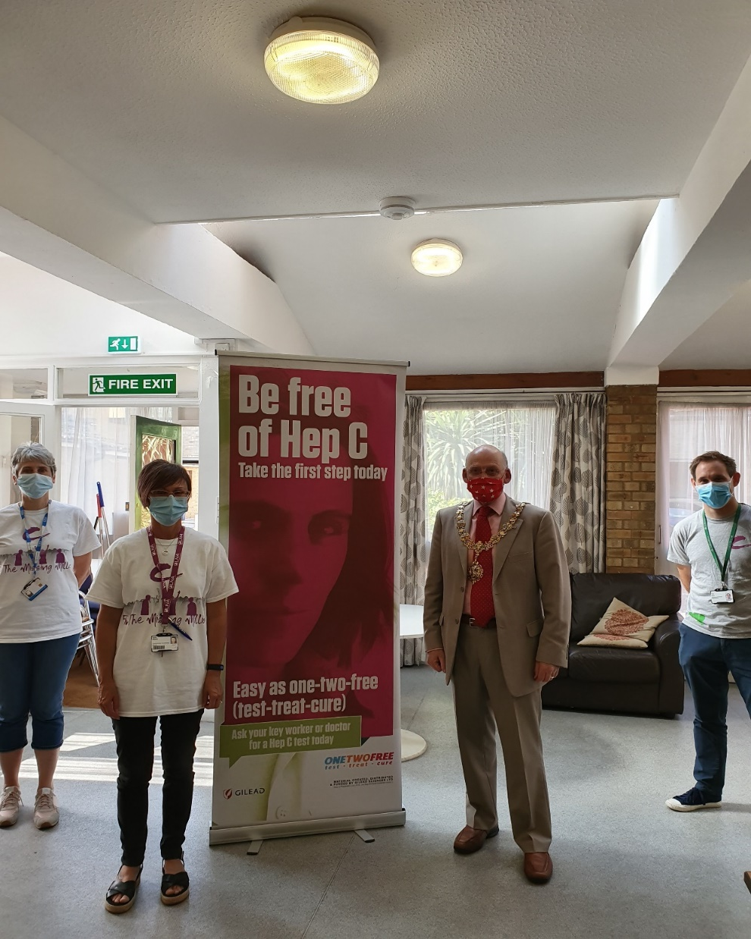
Testing during lockdown
Testing in the homeless/rough sleeper community
Simple, quick testing method
Bedford Prison HITT
Notes:
Been involved in the homeless calls around the region – linking in HCV testing and treatment.
Worked with HCV CNS in the region – peer support Charlotte to support and test in the community
June 2020- October 2020 398 HCV tests, 28 Ab positive, 7 RNA positive.
We test using oraquick mouthswab – follow up by DBST for RNA status – during start of pandemic able to treat with pangenotypic drugs
Bedford Prison HITT – 161 tested – 1 RNA Positive

Slide 9
Initiatives awarded by NHS England to Eastern ODN
Prisons
Community Pharmacy
GP PSI Tool
Approved Premises
Community Van
Notes:
Prisons – Currently not allowing large groups in – prisoners are restricted in access –
Highpoint – we carried funding from last year and will aim to have HITT completed by March 2021
Peterborough – we would like to put some funding towards Peterborough prison – we believe large prevalence and would aim to test and get prisoners onto treatment within one week of the testing.
Community Pharmacy
Initiative where community pharmacy can test People who inject drugs - those who are not engaged with DAS or able to get testing through GP – The test will be a point of care test to test for Antibodies – Paul Selby is working with local LPC to implement this testing.
GP PSI Tool
This is a tool which can run on GPs systems to identify those who could be at risk of HCV. From the lists generated we will be able to screen and write to patients to advise having a HCV test. We are working with the CCG, Central Team and MSD to work out how to get CCG approval so GPs can run the tool (they need to have CCG CSU Approval before they can run the tool). We already have a local GP in Peterborough who would be happy to run the tool on his patient list.
Approved Premises
Bail hostels - we have been awarded some funding to enable testing in AP – we are currently working with service managers for the region to get into the AP and work how we can test residents.
Community Van
We placed a business case/ bid for community ODN van (along with driver and nurse), we hope we will receive some funding allowing us to test/treat in the more rural unmet areas of need in the region

Slide 10
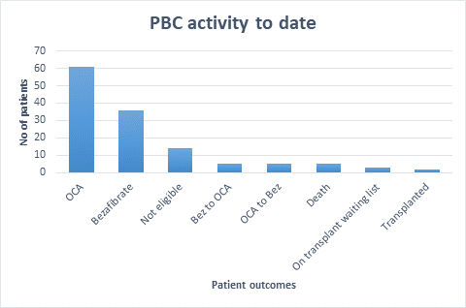
PBC

Slide 11
Referral for Second Line treatment
Referred patients will be seen once face to face with Dr Mells at CUH. Then discussed at MDT
After a year patient will be discharged from CUH if they have responded well to treatment for local follow up.
Guidelines
We are in the process of putting together a management of second line treatment of PBC guideline once this is completed it will be added on the Eastern Liver website.
MDT
We are looking to opening up MDT for discussion and teaching of difficult cases as our MDT it is now virtual.
If patients are going to be discussed directly at the MDT then would it be possible for patient information to be sent to us prior to the MDT?
Patients that are on OCA for over a year and not responded well, we are considering adding Bezafibrate to their treatment.

