Slide 1
Hepatic Encephalopathy
Debbie Shawcross
Professor of Hepatology and Chronic Liver Failure

Slide 2
Disclosures
Consultancy/Advisory Board
Norgine
Kaleido Biosciences
Shionogi
Paid Lectures
Norgine
Falk Pharma
Investigator-initiated grant – Norgine
RIFSYS Trial [A placebo controlled single centre double blind randomised trial to investigate the efficacy of RIFaximin versus placebo in improving SYStemic inflammation and neutrophil malfunction in patients with cirrhosis and chronic hepatic encephalopathy]
EMITTIC Trial [Restoration of disrupted gut mucosa-associated immune cell regulation in patients with cirrhosis and hepatic encephalopathy with rifaximin]
Mallinckrodt

Slide 3

Talk Synopsis
The prognosis of hepatic encephalopathy (HE) and indications for liver transplantation.
Early diagnosis of HE.
Pathogenesis and precipitating factors.
The management principles underpinning the acute management of HE.
Specific therapies for HE and prevention of the recurrence of overt HE.
Targeting the gut microbiome in the treatment of HE.
HE

Slide 4
Mortality rates over 5 years for cirrhotic patients with/without HE
Complication of cirrhosis:
100
Hepatic encephalopathy
80
Ascites + variceal bleeding
Ascites alone
60
Variceal bleeding alone
Mortality (%)
No complications
40
20
N=466 patients with cirrhosis
One-year mortality was 17% among patients with no initial complications and 64% following HE
0
0
1
2
3
4
5
Years after onset of complications
Jepsen P, et al. Hepatology 2010 51:1675–82.
Notes:
HE itself has been observed to have an independent negative effect on survival.^{1,2} One study, investigated the clinical course of alcohol-related cirrhosis in a cohort of 466 Danish patients by conducting a retrospective medical chart review.¹ The graph here highlights the high mortality associated with HE, over and above the mortality associated with liver disease on its own.
1. Jepsen P, Ott P, Andersen PK, Sørensen HT, Vilstrup H. Clinical course of alcoholic liver cirrhosis: A Danish population based cohort study. Hepatology. 2010;51(5):1675-82.
2. Bustamante J, Rimola A, Ventura P, Navasa M, Cirera I, Reggiardo V, et al. Prognostic significance of HE in patients with cirrhosis. Journal of hepatology. 1999;30(5):890-5.

Slide 5
Overt HE is associated with poor prognosis
<50% survival at 1 year after diagnosis of HE;
<25% survival at 3 years
100
42% survival at 1 year
80
23% survival at 3 years
60
Survival, %
40
20
0
0
12
24
36
48
Months
Bustamante et al. J Hepatol. 1999;30:890-895.

Slide 6
Early referral for liver transplantation

Slide 7
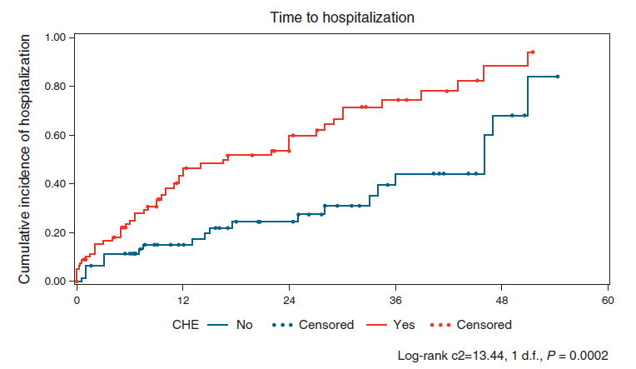
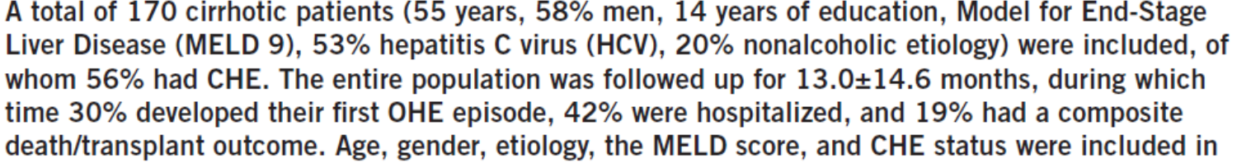

Covert HE is independently associated with increased risk of hospitalisation

Slide 8
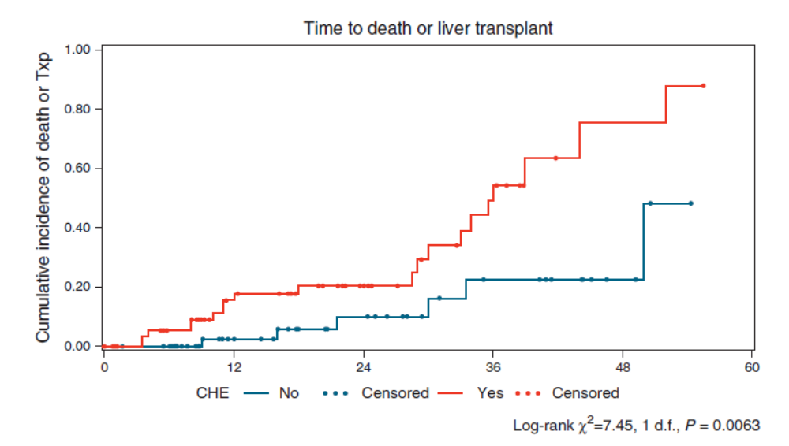
Covert HE is independently associated with poor survival
Patidar K et al. AJG 2014

Slide 9

Early diagnosis of hepatic encephalopathy
? Ammonia
?neuropsychometric tests
? EEG

Slide 10

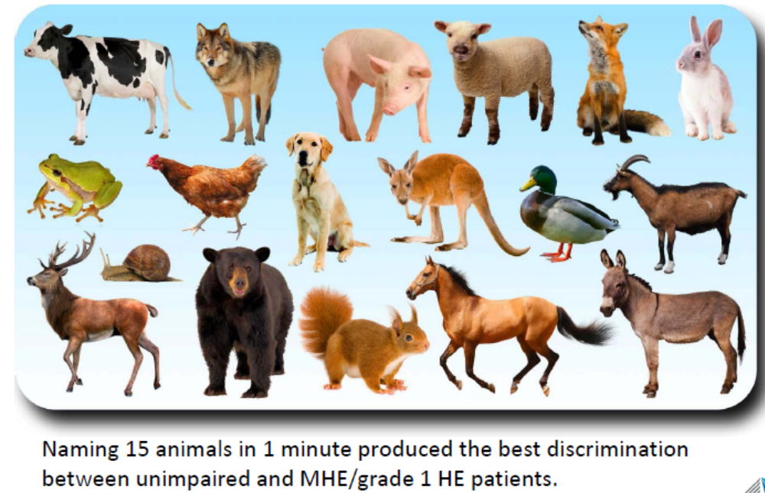

Slide 11
The Animal Naming Test: an easy tool for the assessment of HE

Slide 12

Pathogenesis and precipitating factors

Slide 13
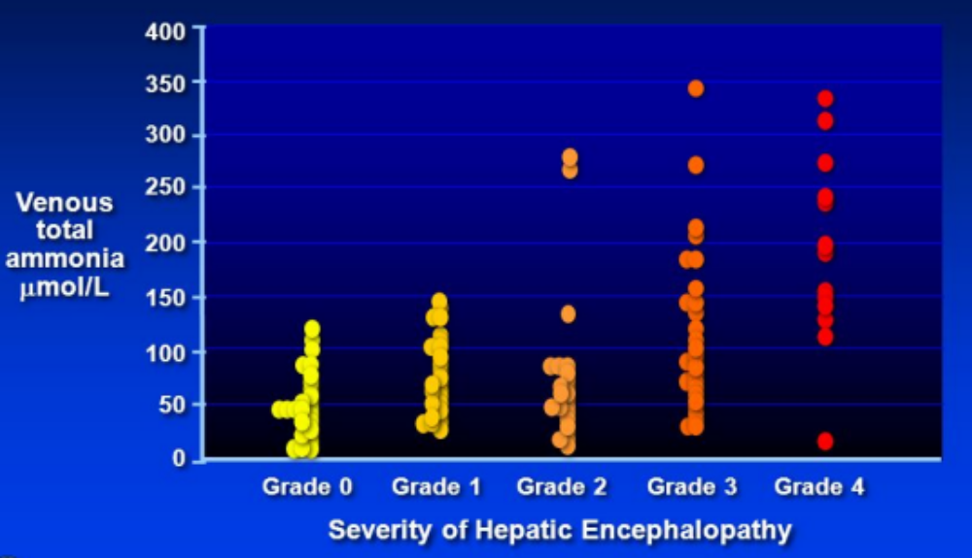
Ammonia is not a reliable biomarker of HE in cirrhosis but when high is likely to portend a poor prognosis
400
300
200
µmol/L
100
Episode of overt HE
0
Ammonia
Healthy
Cirrhosis
TIPSS
ACLF
ALF
ICP
>25 mmHg
Time
Olde Damink SWM et al. Neurochem. Int. 2002;41(2-3):177-88.
Ong JP et al. Am J Med 2003; 15;114(3):188-93.

Slide 14
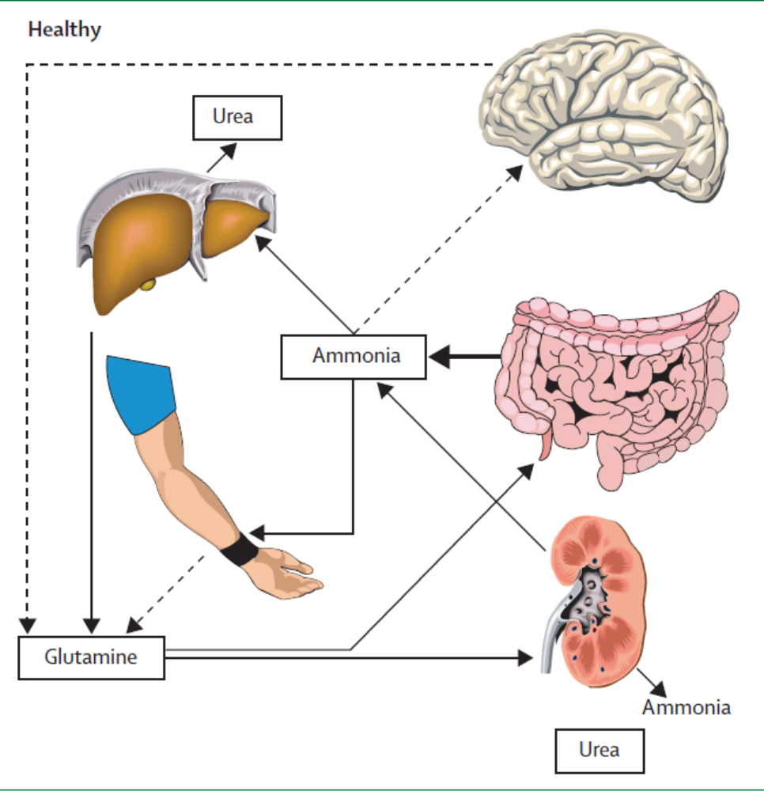
Interorgan trafficking of ammonia in health and in cirrhosis
In healthy individuals, the liver removes ammonia by detoxification into urea.
In patients with cirrhosis the metabolic capacity is reduced resulting in hyperammonemia.
Muscle becomes an important organ of detoxification into glutamine.
Glutamine acts as a temporary buffer that can both regenerate ammonia (enterocytes) and excrete ammonia (kidneys).
Shawcross D et al. Lancet 2005; 365: 431-33.

Slide 15
Ammonia-glutamine-brain swelling hypothesis
ASTROCYTE
GLUTAMINE
Ammonia
GLUTAMATE
H₂0
NH₃
H₂0
H₂0
GLUTAMINE
H₂0
H₂0
Astrocyte swelling &
increased brain water
Cordoba et al. The development of low-grade cerebral oedema in cirrhosis is supported by the resolution of ¹H-magnetic resonance abnormalities after liver transplantation. J of Hepatol. 2001

Slide 16
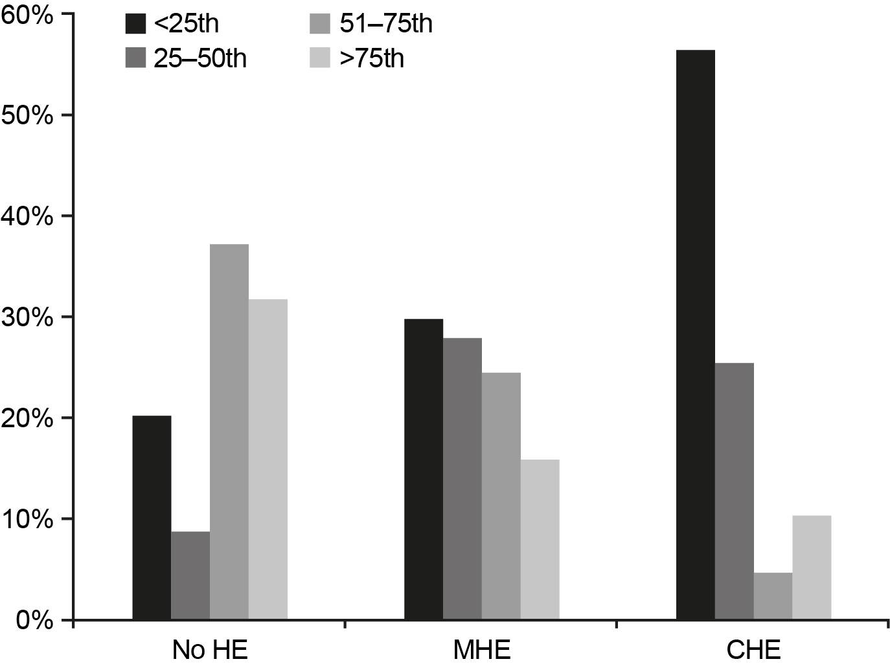
Overt and Covert HE are more frequent in cirrhotic patients with decreased muscle mass and muscle function
Mid-arm muscle circumference (MAMC) in 200 male cirrhotic patients
<25th centile = <20.8cm MAMC
Merli M et al. Metab Brain Dis 2013;28(2):281-284.
HE= Hepatic encephalopathy

Slide 17
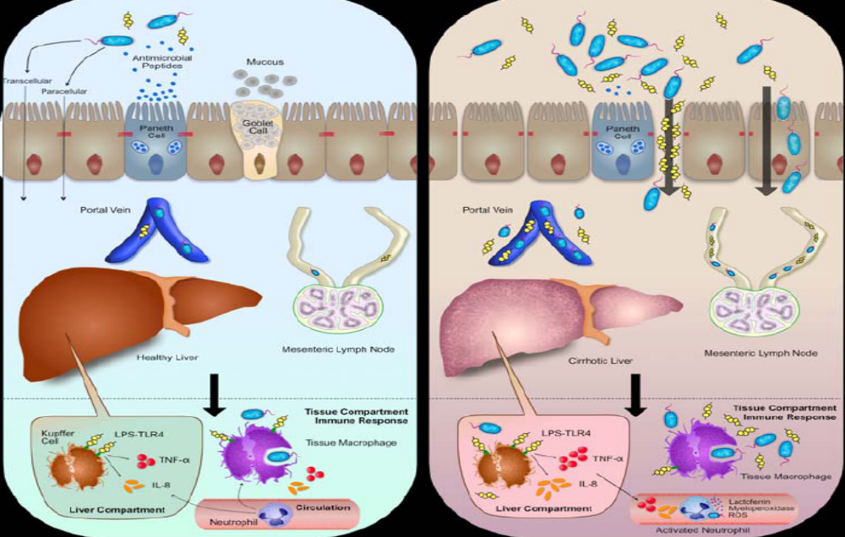
Movement of bacteria from the gut lumen to the liver in health and in cirrhosis generates inflammation
Woodhouse C et al. APT 2018;47(2):192-202.

Slide 18
Precipitating factors
Re-admission
HE
Stable at home
Ammonia load
(GI bleeding; TIPSS; constipation)
Infection
Hyponatremia
Dehydration / Diarrhoea / Renal Failure
Metabolic alkalosis
Sedative drugs e.g. benzodiazepines

Slide 19
Hyponatremia and risk of developing encephalopathy
Hepatic
encephalopathy
Hepatorenal
syndrome
Spontaneous
bacterial peritonitis
≤130 mmol/l (n=211)
131–135 mmol/l (n=275)
Gastrointestinal
bleeding
>135 mmol/l (n=497)
0
10
20
30
40
50
Percentage of patients with complications of cirrhosis within a 4-week period of the index visit classified according to serum sodium concentration
N=997 (serum Na values missing for 14 patients)
Angeli et al. Patient population survey. Hepatology 2006

Slide 20
Treatment Principles

Slide 21
Acute Hepatic Encephalopathy Algorithm
Severity of HE
Grade 1/2
Grade 3/4
Identify and treat
precipitating factor(s)
Transfer to HDU/ICU
Intravenous fluids
Empirical Antibiotics
Airway Protection
Intravenous Fluids
Enema/Lactulose/
Polyethylene glycol
(as appropriate)
Empirical Antibiotics
Enemas
Hemofiltration

Slide 22
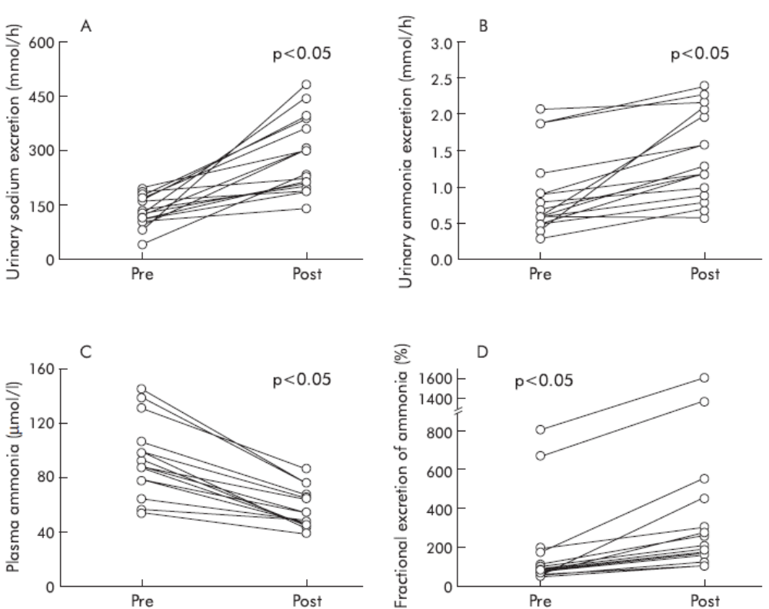
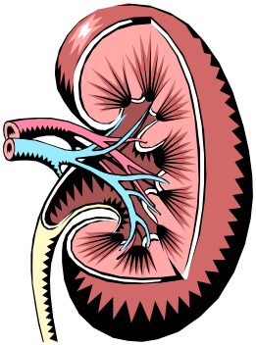
Enhanced renal ammonia excretion following volume expansion in cirrhosis
Adapted from Jalan, R., and D. Kapoor. Gut 52.7 (2003): 1041-1045.

Slide 23
HE-specific therapies

Slide 24
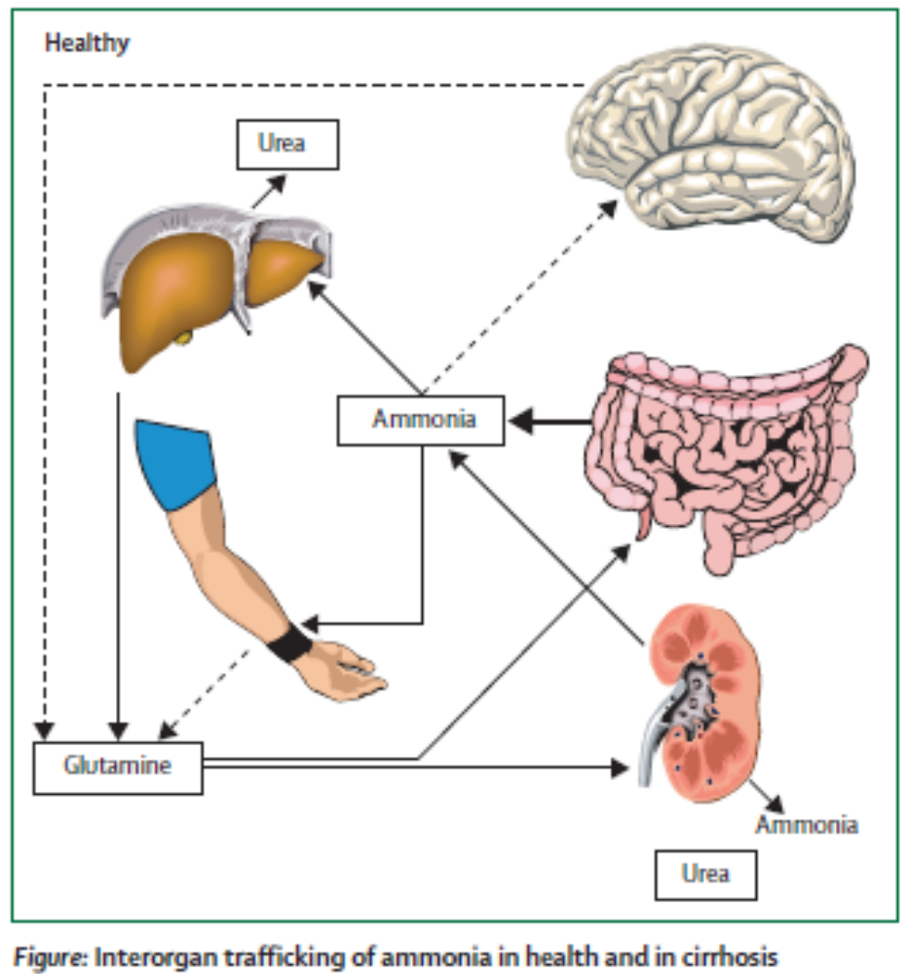
Overview of Current Therapies for HE
L-Ornithine L-Aspartate
Branched Chain Amino Acids
Sodium Benzoate
Ornithine Phenylacetate
Glycerol Phenylbutyrate
Lactulose
Rifaximin-α
Neomycin
Probiotics
Faecal Microbiota Transplantation
Haemodialysis
Hemofiltration
Fluid Expansion
Shawcross D et al. Lancet 2005; 365: 431-33.

Slide 25
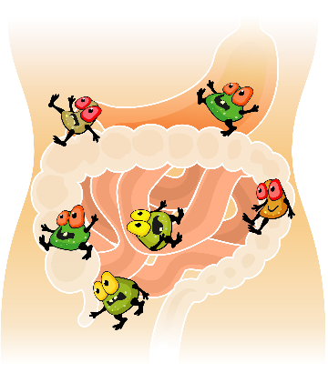
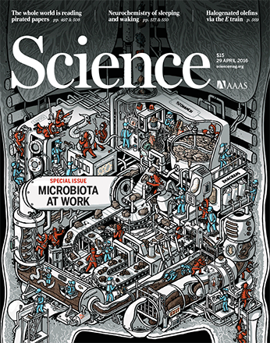

Could the gut microbiome contribute to the development of hepatic encephalopathy?

Slide 26
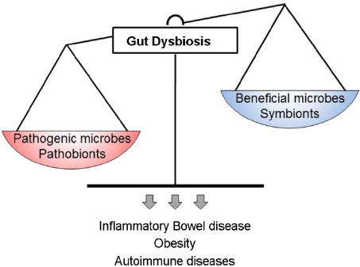
‘Gut dysbiosis’ in cirrhosis
Imbalance of bacteria in your gut
Lose beneficial microbes in your gut
Opportunistic bacteria take over (potentially harmful bacteria which are kept in check by beneficial microbes)
You have less diversity in your gut
Bajaj JS et al. J Hepatol. 2014; 60(5): 940-7.

Slide 27
Stool microbial diversity is reduced in cirrhosis
Health
Cirrhosis
Healthy
Cirrhosis
Higher abundance of bacteroidetes
Reduction in actinobacteria and firmicutes in cirrhosis
Patel VC et al. Results of a placebo-controlled double blind randomised trial
to investigate the efficacy of rifaximin-α versus placebo in improving systemic
inflammation in patients with cirrhosis and chronic hepatic encephalopathy
(RIFSYS Trial). Journal of Hepatology 2018; 68: S105-364. LBA 005.

Slide 28
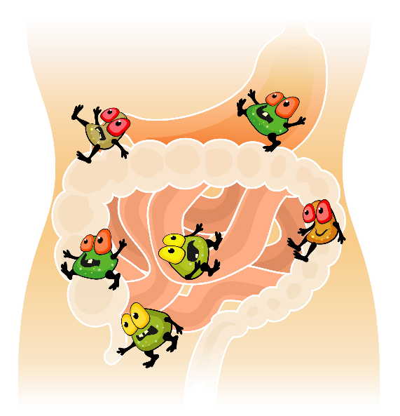
Modulating the gut microbiota in cirrhosis to prevent HE
Lactulose
Rifaximin
Faecal microbiota transplantation

Slide 29


Mechanism of Action of Lactulose in the Gut
Lactulose
Passes through gut unmetabolised to colon
Supplies carbohydrate and energy
Increasing bacterial mass
which utilises ammonia
and amino acid nitrogen
↓ammonia production
Lactic Acid + Acetic Acid
pH ↓ NH₃ + H⁺ ↔ NH₄⁺
Reduced bacterial ammonia production
COLON
Altered bacterial metabolism
↓ammonia production
↓ Colonic Transit Time
with ↓ ammonia residence time and ↓ time for ammonia generation

Slide 30
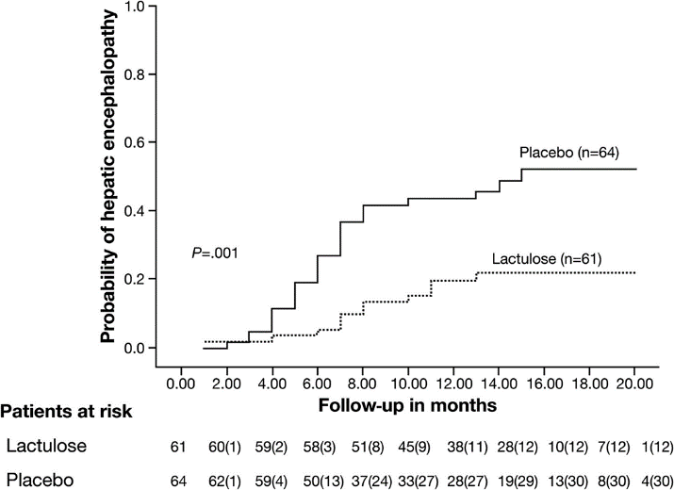
Secondary Prophylaxis of Hepatic Encephalopathy
An open-label randomized controlled trial of lactulose versus placebo in prevention of overt HE
Probability of developing HE in patients receiving lactulose (dotted line) or placebo (continuous line). Figures in parentheses indicate the cumulative number of subjects who developed HE.
Sharma BC et al. Gastroenterology 2009; 137: 885-91.

Slide 31
Modulating the gut microbiota in cirrhosis to prevent HE
Lactulose
Rifaximin
Faecal microbiota transplantation

Slide 32
Selective gut decontamination (rifaximin-α)
Proportion of patients experiencing a breakthrough of overt hepatic encephalopathy over 6 months
100
80
Absolute
risk
reduction
60
45.9%
Patients (%)
40
23.8%
22.1%
20
(n=31)
(n=73)
0
Rifaximin-α 550 mg bd +
91.4% on concomitant lactulose
(n=140)
Placebo + 91.2% on
concomitant lactulose
(n=159)
Treatment
Bass et al. NEJM 2010; 362(12)
Notes:
The proportion of patients experiencing a breakthrough episode of HE in the Rifaximin-α 550 mg bd group* vs. placebo group* was 31/140 (22.1%) vs. 73/159 (45.9%).²
*91% of patients (n=273) received concomitant lactulose drug in the study.

Slide 33
Rifaximin suppresses the growth of oral originating species in the gut microbiome and bacteria with mucin-degrading capacities
Patel VC, Lee S, Edwards LAE, Shoaie S and Shawcross D 2020 (manuscript in preparation)

Slide 34
Modulating the gut microbiota in cirrhosis to prevent HE
Lactulose
Rifaximin
Faecal microbiota transplantation

Slide 35
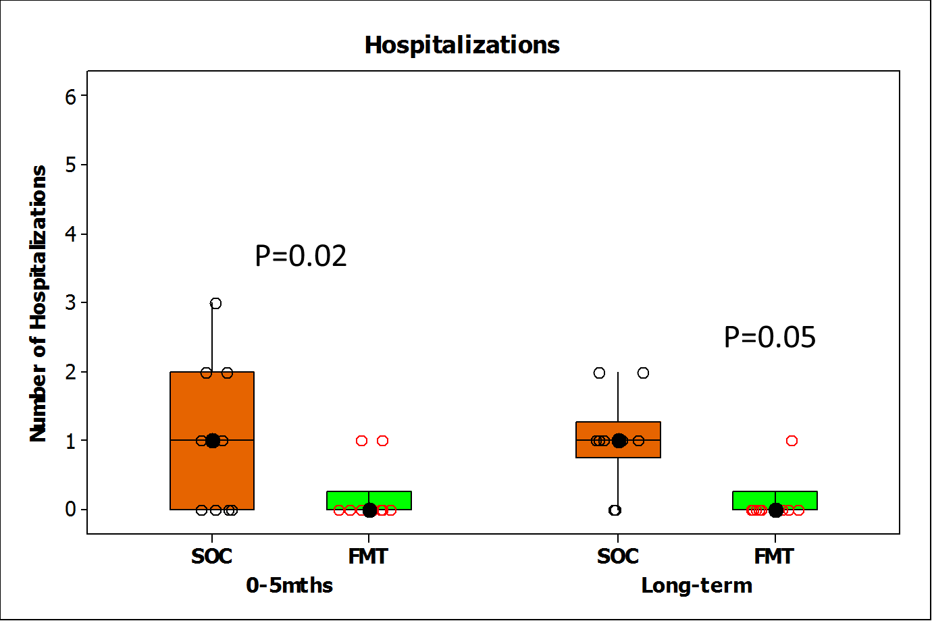
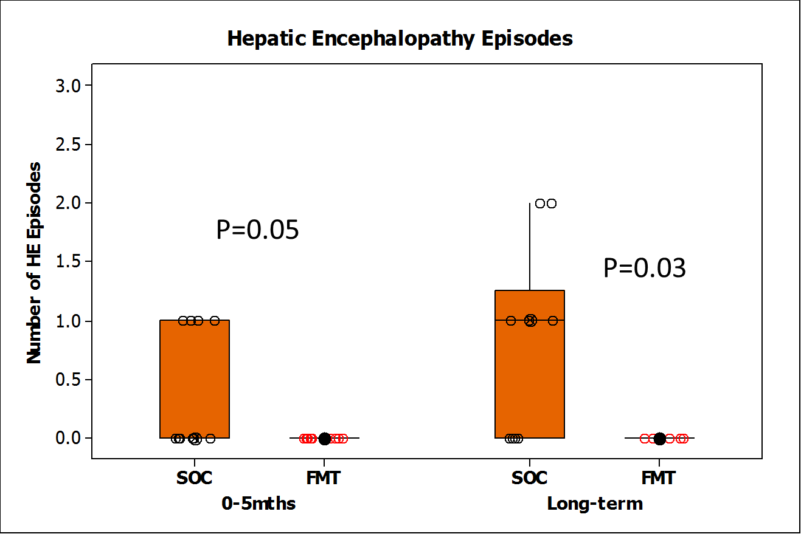
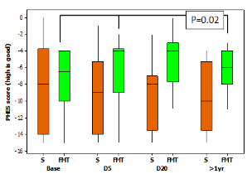
Safety of FMT administered by enema
Bajaj JS et al. Hepatology 2017; 66(6): 1727–1738
Bajaj JS et al. Gastro 2019 May;156(6):1921-1923

Slide 36
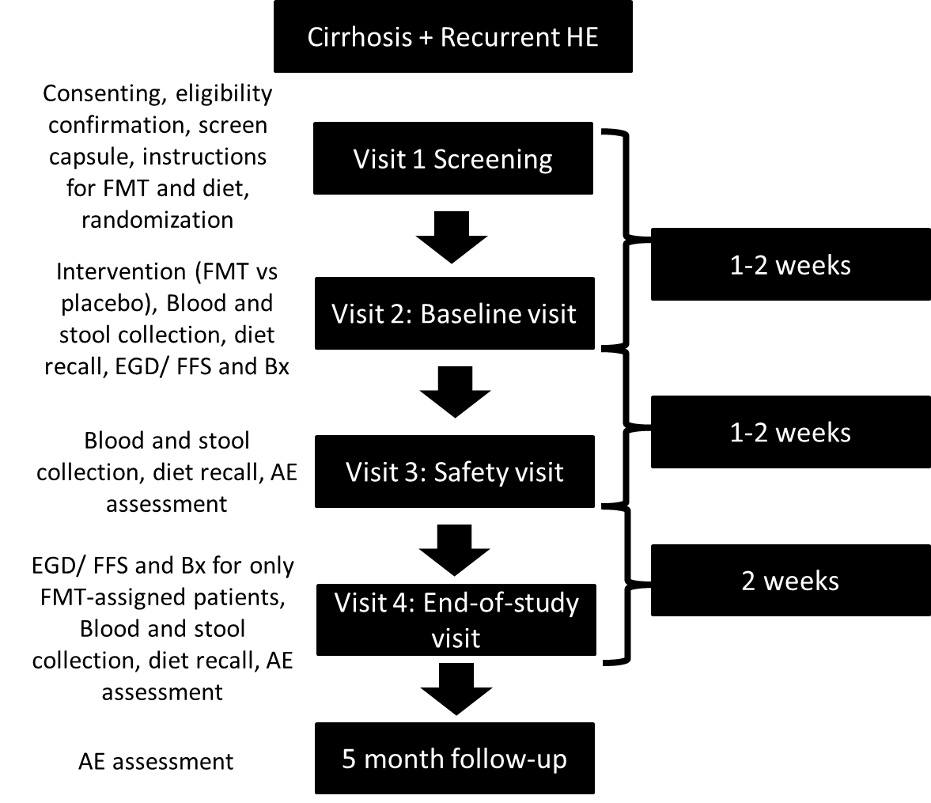
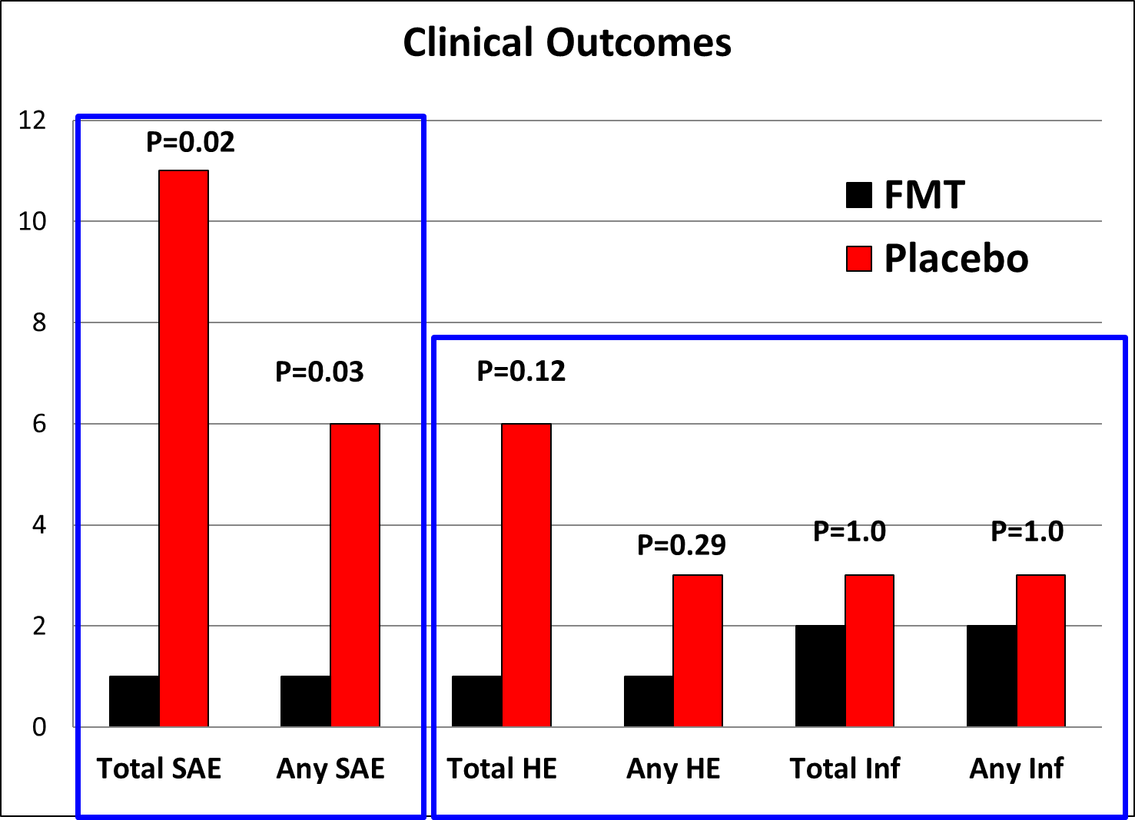
FMT Capsules Are Safe in Hepatic Encephalopathy: A Phase 1, Randomized, Placebo‐Controlled Trial
Patients with cirrhosis with recurrent HE with MELD <17 on SOC were randomized 1:1 into receiving 15 FMT capsules versus placebo from a single donor enriched in Lachnospiraceae and Ruminococcaceae.
Bajaj JS et al Hepatology 2019 (in press)

Slide 37
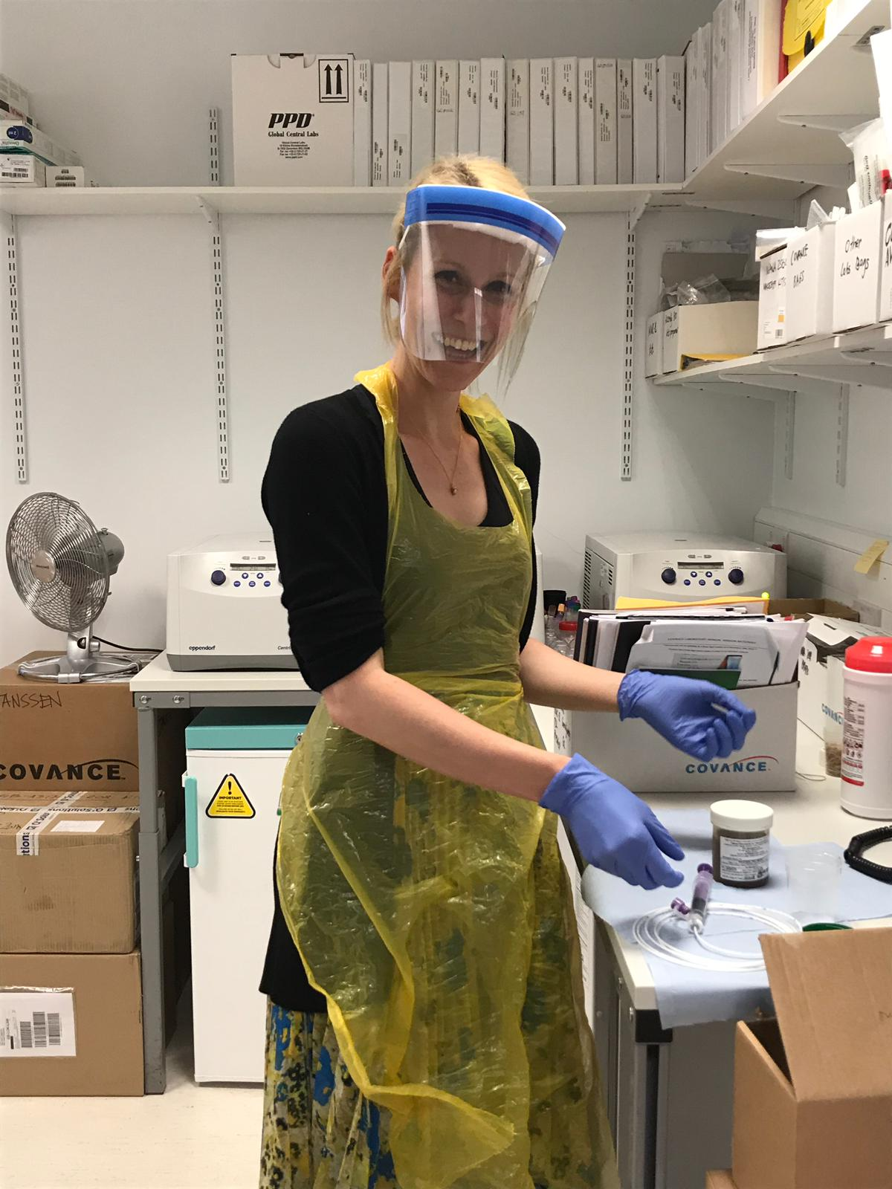
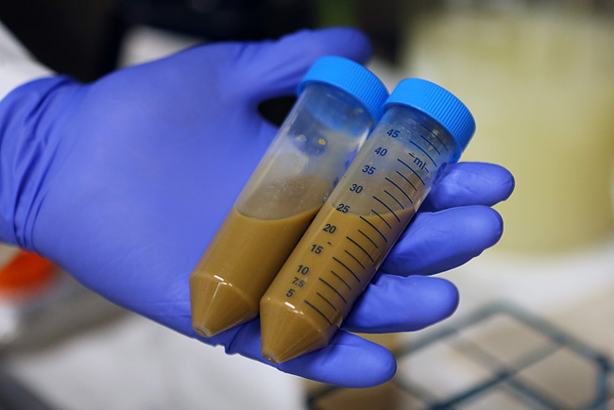

PROFIT: PROspective, randomised placebo-controlled feasibility trial of Faecal mIcrobiota Transplantation in cirrhosis
3:1 allocation (single-blinded)
32 patients [24 FMT and 8 placebo]
50g stool in 200mL 0.9% saline with 12.5% glycerol (frozen)
Manufactured in MHRA licensed facility
Rigorous donor screening including for Extended Spectrum Beta-Lactamase (ESBL) producing bacteria
Bowel preparation with 2 sachets of Moviprep
Nasojejunal instillation at gastroscopy
No antibiotics or rifaximin (for 14 days pre-FMT)
90-day follow-up
Woodhouse CA et al. BMJ Open 2019;9(2):e023518.

Slide 38
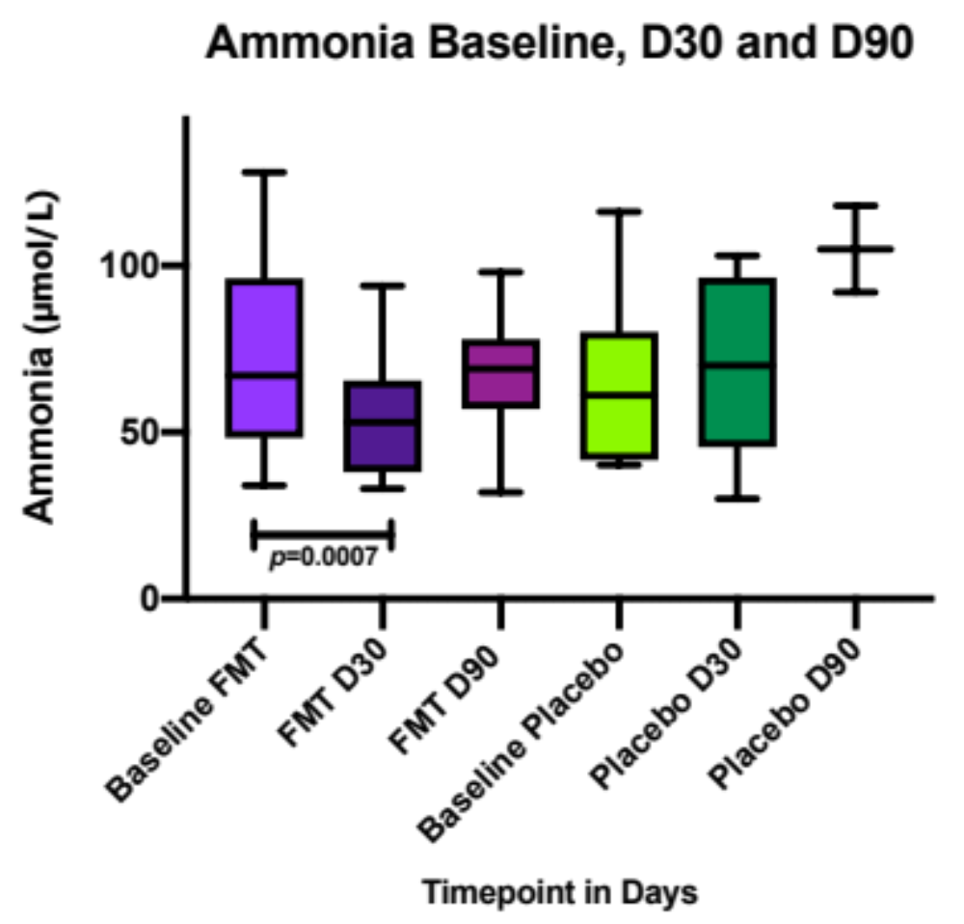
Change in blood ammonia with FMT in patients with cirrhosis
Woodhouse C et al. PROFIT Trial 2019 (unpublished data)
Notes:
Box and whisker plot of ammonia values showing mean with 95% CI in FMT and placebo groups
Why does the ammonia increase at D90? Possibly due to impact of bowel prep on placebo group?

Slide 39
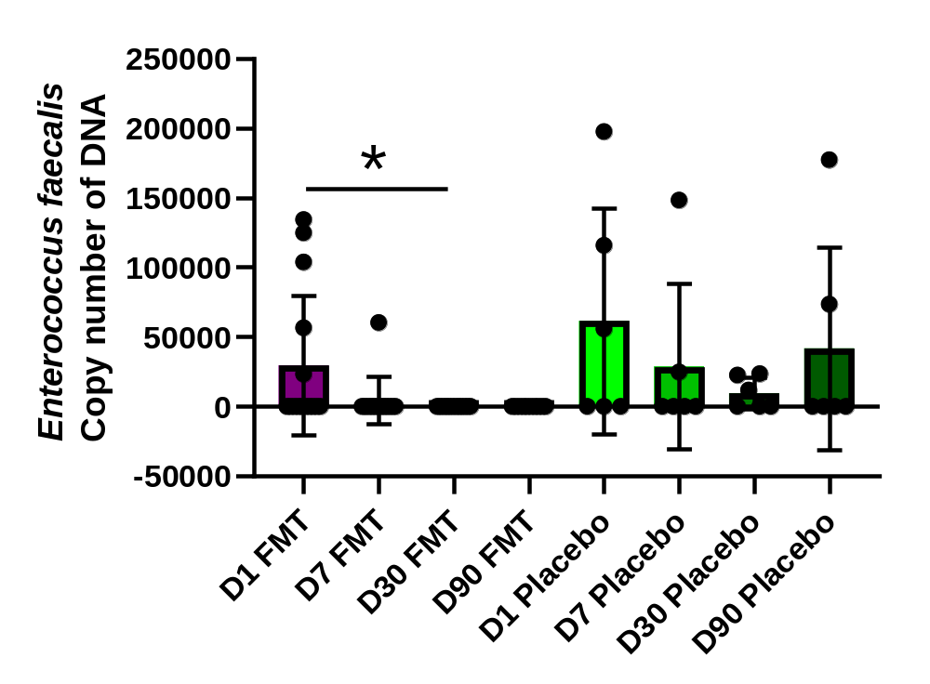
FMT reduces Enterococcus Faecalis
p=0.02
Woodhouse C et al. PROFIT Trial 2019 (unpublished data)

Slide 40
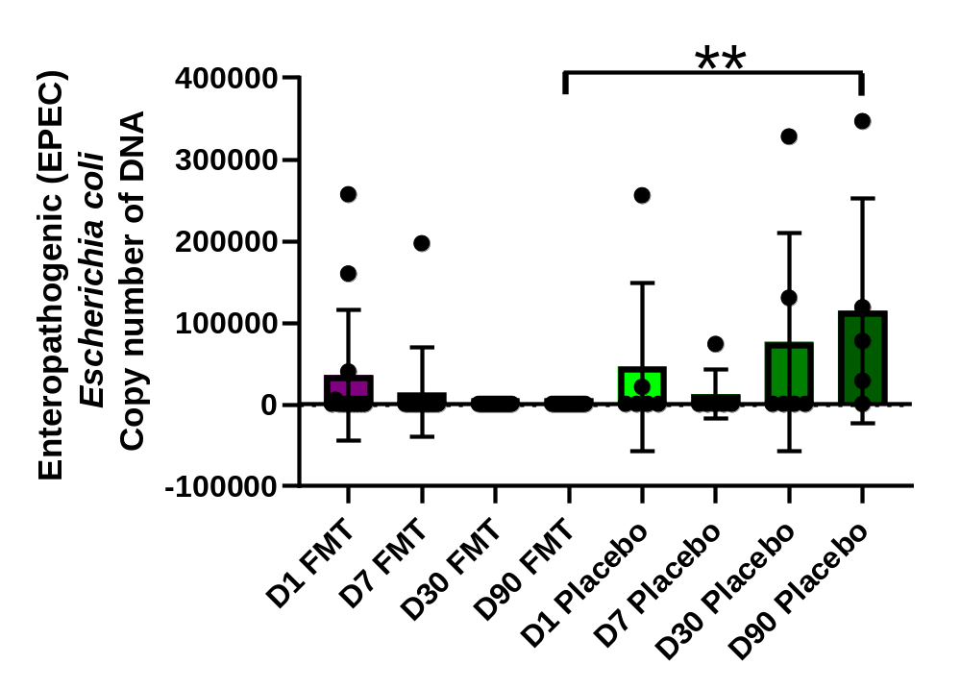
FMT reduces Enteropathogenic E. coli
p=0.0007
Woodhouse C et al. PROFIT Trial 2019 (unpublished data)

Slide 41
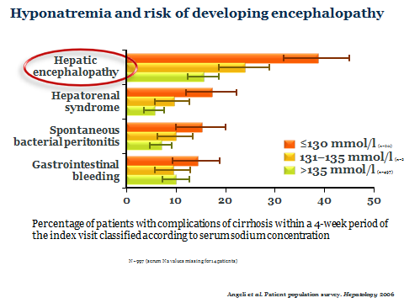
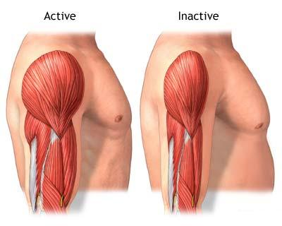
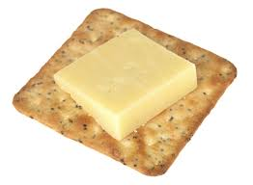

Prevention top 3 tips!
Avoid hyponatraemia
Bedtime snack
Exercise and build muscle mass
Ammonia
Plank LD et al. Hepatology 2008;48:557-66.
Swart GR et al. BMJ 1989;299:1202-3.
Tsien CD et al. J Gastroenterol Hepatol 2012;27:430-41.

Slide 42
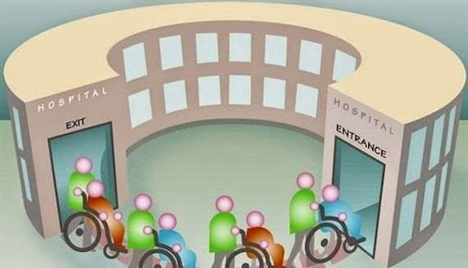
HE: The revolving door
HE prophylaxis may confer additional benefits to your cirrhotic patients to keep them at home

Slide 43
My 6 ‘golden rules’ in the management of HE
Early identification/diagnosis - animal naming test
Early referral for liver transplantation in those suitable.
Identify and correct the precipitating factors
Prevention
    Avoid hyponatremia
    Nutrition (Bedtime snack)
    Exercise and build muscle
    Stop PPIs
    Mediterranean Diet
Secondary prevention of HE
    Lactulose and/or rifaximin
Intervene early to prevent readmission
HE

Slide 44


THANK YOU
Debbie Shawcross
Professor of Hepatology & Chronic Liver Failure
Institute of Liver Studies
King’s College London

