Slide 1
Coagulation and liver disease
Will Thomas (Consultant Haematologist) & Stephen MacDonald (Clinical Scientist)
Cambridge Liver Symposium 6th November 2020

Slide 2
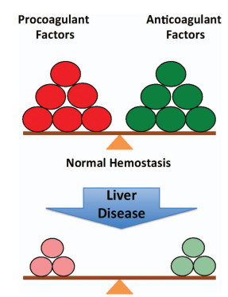
Introduction
Impaired synthetic function in CLD
  Thrombocytopenia (portal hypertension)
  Increased PT (INR)
  +/- increased aPTT
  Decreased fibrinogen
  FBC: Increased MCV and anaemia
  But these are only the tests we measure
    e.g. antithrombin/protein C and S
Kujovich, Hematology, 2015, 243-9

Slide 3
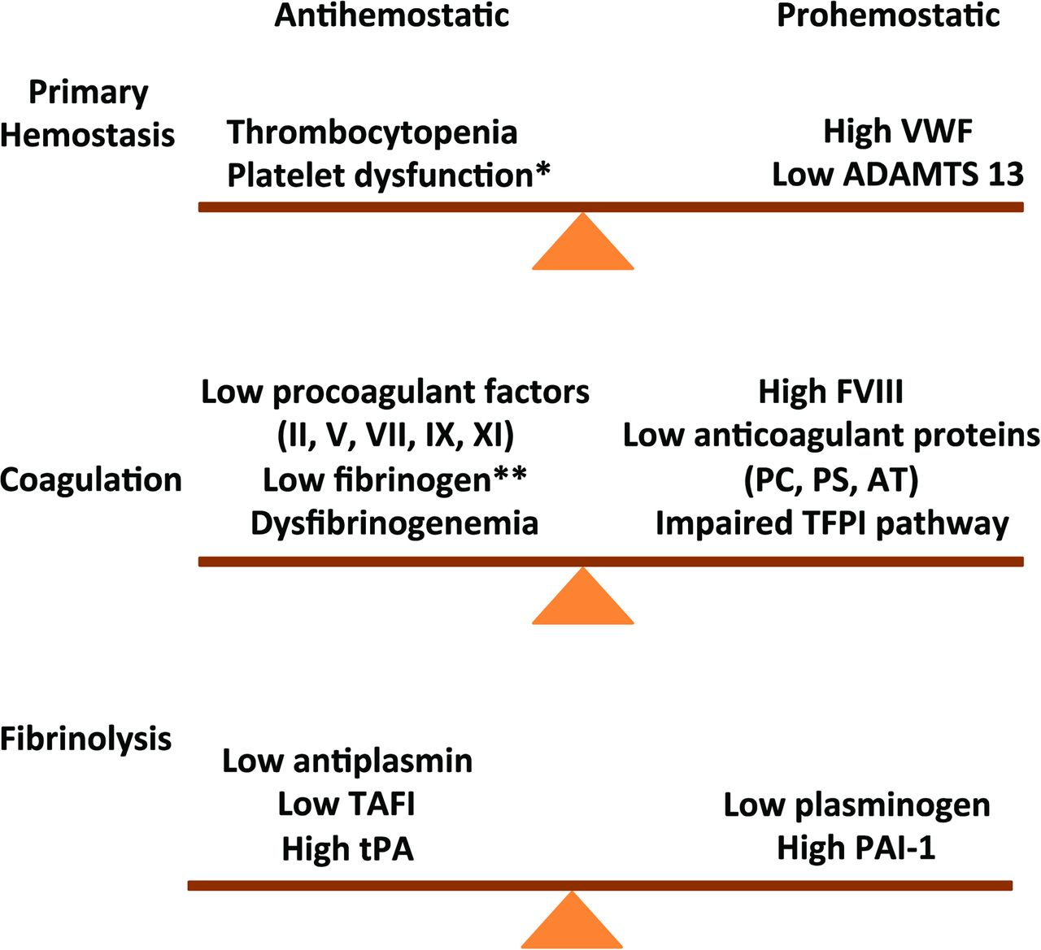

Coagulopathy in liver disease: a balancing act
Jody L. Kujovich, Coagulopathy in liver disease: a balancing act, Hematology Am Soc Hematol Educ Program, 2015, Figure 2.
Copyright © 2020 American Society of Hematology
Notes:
Figure Legend:
Rebalanced hemostasis in chronic liver disease. Primary hemostasis: high VWF levels and low ADAMTS 13 levels counteract defects in primary hemostasis. Coagulation: reduced levels of procoagulant factors are balanced by a parallel decline in anticoagulant factors. Fibrinolysis: fibrinolysis is rebalanced by parallel changes in profibrinolytic and antifibrinolytis proteins. VWF indicates von Willibrand factor; ADAMTS 13, a disintegrin & metalloproteinase with thrombospondin type 1 motif 13; PC, protein C; PS, protein S; AT, antithrombin; * does not occur consistently in chronic liver disease; and **end-stage liver disease.

Slide 4

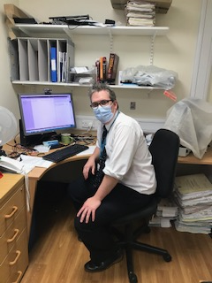
Why does this all matter?
Haematology ST3 on the first Friday of August…
Patient with CLD needs a radiologically guided drain for a axillary abscess
INR 1.6 and platelets 49x10*9/l
Hepatology SHO called the haematology reg to ask for platelets (x1 unit) and plasma (4 units)

Slide 5
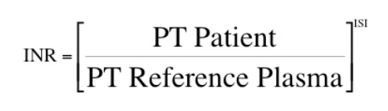
The INR
A test designed to standardise warfarin dosing across different sites and different laboratories where different reagents and analysers are worked

Slide 6
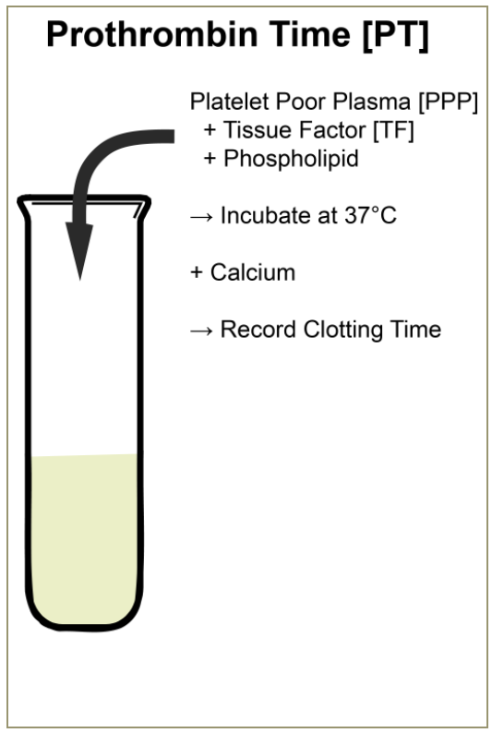
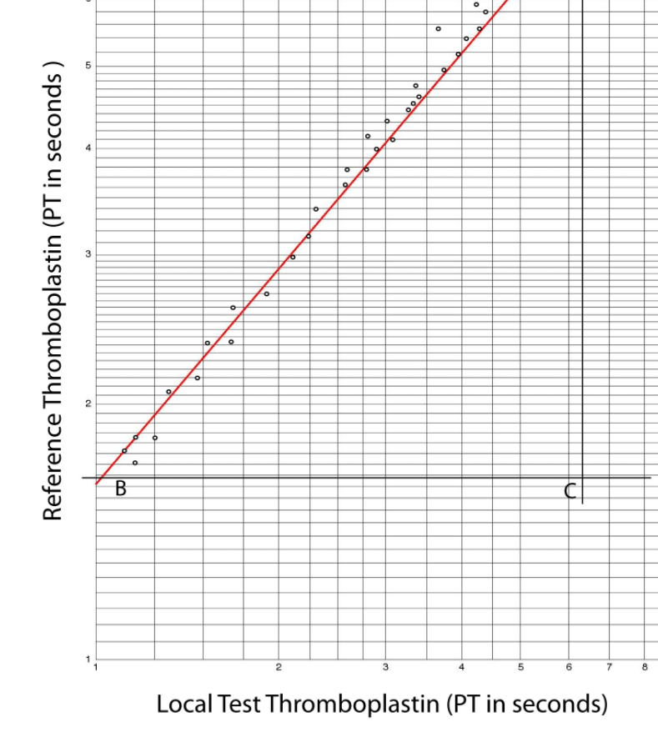

Slide 7
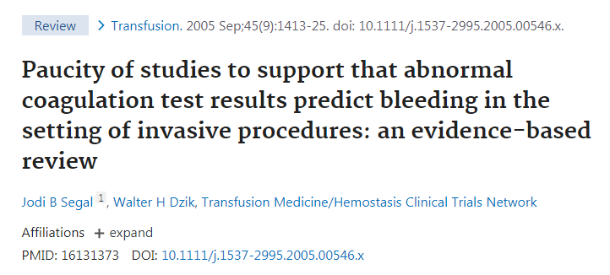

1 trial and 24 observational studies of patients undergoing procedures (liver biopsy, CVP lines, bronchoscopy)

Slide 8
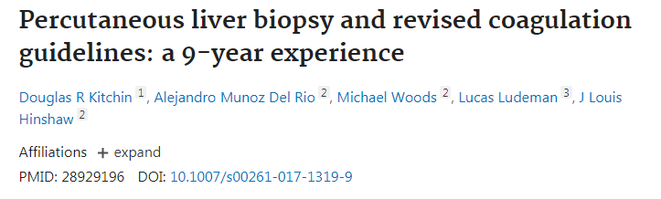
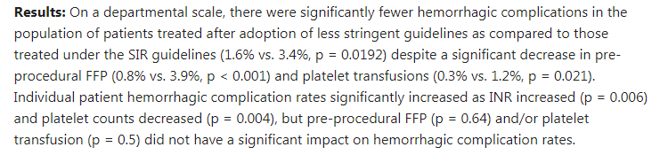
Pre- and post- study using transfusion thresholds of INR >1.5 & platelets <25 v INR >2.0 & platelets <50 in 1740 patients needing liver biopsy
Coagulation markers may be a proxy for liver fibrosis and portal hypertension which are risk factors for bleeding

Slide 9
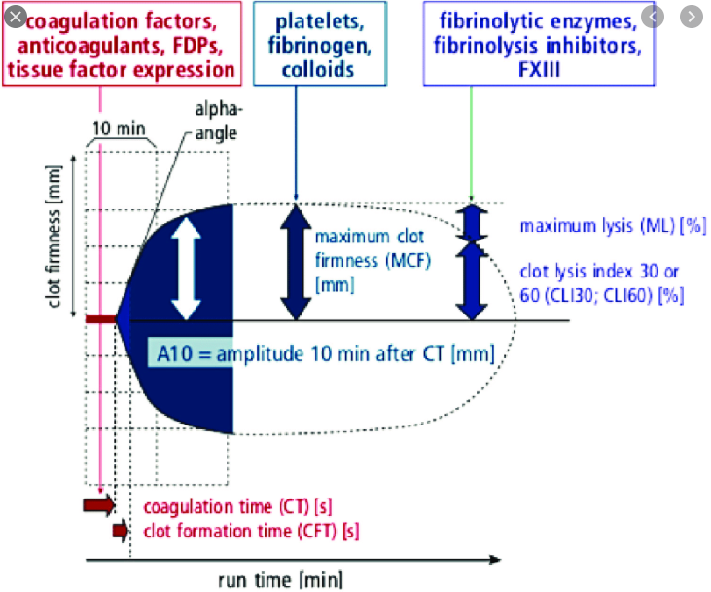
TEG and ROTEM
Pin and cup
Movement of one or the other
Machine detects formation of a clot
Whole blood
Near to the patient

Slide 10
Trial of TEC v conventional coag tests (CCT) for patients with liver disease needing an invasive procedure
60 patients
RCT – between TEG and CCT
All patients CLD with platelets <50x10*9/l and/or INR >1.8
All patients had procedures
Endpoints: bleeding and blood product use
Outcome:
  16% (TEG) transfused v 100% (CCT)
  1 patient bled after large vol paracentesis (CCT)
De Pietri L, Bianchini M, Montalti R, De Maria N, Di Maira T, Begliomini B, Gerunda GE, di Benedetto F, Garcia-Tsao G, Villa E. Thrombelastography-guided blood product use before invasive procedures in cirrhosis with severe coagulopathy: A randomized, controlled trial. Hepatology. 2016 Feb;63(2):566-73.

Slide 11
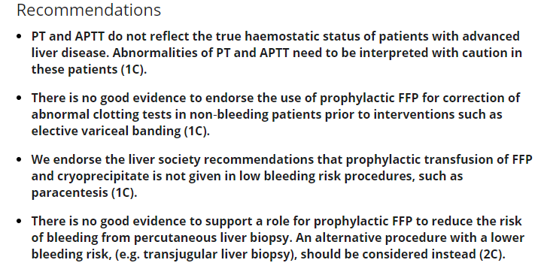

BCSH guidance
Green, L., Bolton‐Maggs, P., Beattie, C., Cardigan, R., Kallis, Y., Stanworth, S.J., Thachil, J. and Zahra, S. (2018), British Society of Haematology Guidelines on the spectrum of fresh frozen plasma and cryoprecipitate products: their handling and use in various patient groups in the absence of major bleeding. Br J Haematol, 181: 54-67. doi:10.1111/bjh.15167

Slide 12
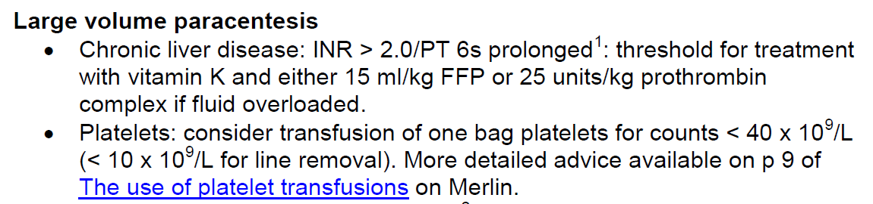
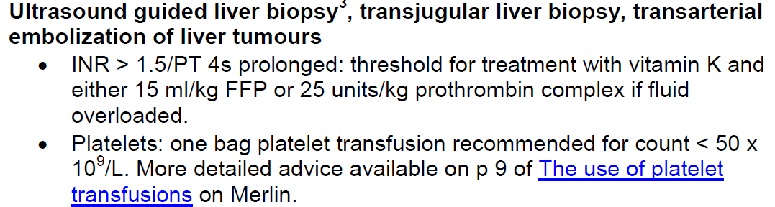
CUH IR recommendations

Slide 13
Summary
Current coagulation tests are rather limited and correlate poorly with risk
Currently don’t have a test that predicts bleeding
We should try and have local protocols based on pragmatic values and harmonise practice
  Saves on wasted resources transfusing FFP
  Benefits and harms of FFP and platelets need RCT

